Slide 1
Technology Development and Transfer under the UNFCCC
Eastern Europe NDE Forum | 7-9 September 2026 | Baku, Azerbaijan
Pauline Namutebi
Climate Technology Sub-Division, UNFCCC
Notes:
Good morning,
My name is Pauline Namutebi, and I work with the Climate Technology Sub-Division at the UN Climate Change secretariat.
In this presentation, I will provide a brief introduction to technology development and transfer under the UNFCCC and the Paris Agreement.
I will start with how technology has evolved under the climate change process, from the Convention through to the establishment of the Technology Mechanism and the Paris Agreement. I will then highlight some of the more recent developments, including the Belém Technology Implementation Programme, before briefly outlining the current intergovernmental process and the work of the secretariat in supporting technology development and transfer.
The aim is to provide some context for the discussions we will have during this Forum and to highlight opportunities for NDEs under broader UNFCCC technology architecture.

Slide 2
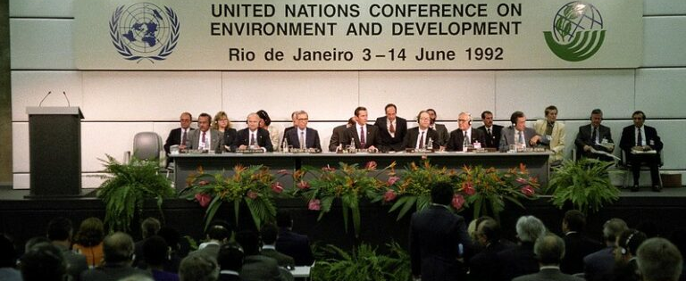
Technology under the United Nations Framework Convention on Climate Change
1992 - Rio Earth Summit | UNFCCC | Article 4 of the Convention
“All Parties … shall promote and cooperate in the development, application and diffusion, including transfer, of technologies, practices and processes that control, reduce or prevent anthropogenic emissions of greenhouse gases…” Article 4.1(c)
“The developed country Parties … shall take all practicable steps to promote, facilitate and finance, as appropriate, the transfer of, or access to, environmentally sound technologies and know-how to other Parties, particularly developing country Parties, to enable them to implement the provisions of the Convention.” Article 4.5
Notes:
Let me begin with the foundation for technology development and transfer under the UNFCCC.
Technology has been recognized as an important means for addressing climate change since the adoption of the Convention in 1992.
Article 4.1(c) establishes a broad commitment for all Parties to promote and cooperate in the development, application and diffusion, including transfer, of technologies that help reduce or prevent greenhouse gas emissions.
Article 4.5 further emphasizes the role of developed country Parties in promoting, facilitating and financing, as appropriate, the transfer of and access to environmentally sound technologies and know-how, particularly for developing countries.
These provisions established the basis for the technology-related institutions, frameworks and programmes that were subsequently developed under the Convention.
So, when we talk about technology development and transfer today, we are building on a mandate that has been part of the climate process from the beginning.

Slide 3
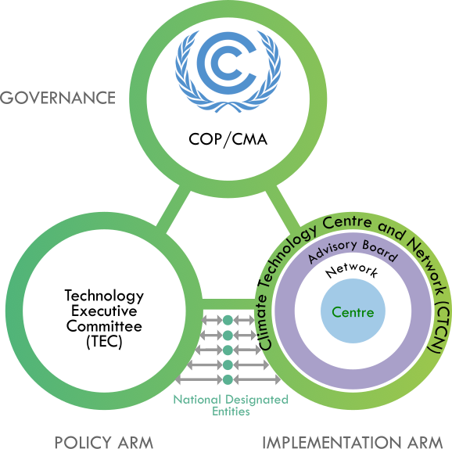
Milestones on climate technology under the UNFCCC
2001: Technology Transfer Framework
2007: Enhanced Technology Transfer Framework and NDEs
2008: Poznan Strategic Programme on Technology Transfer
2010: Technology Mechanism (TEC & CTCN)
Technology Mechanism
Notes:
From this foundation in the Convention, Parties progressively developed a more structured architecture for technology development and transfer.
In 2001, Parties established the Technology Transfer Framework to provide a basis for actions to enhance technology development and transfer.
This framework was further enhanced in 2007, including through greater attention to institutional arrangements and the role of national focal points, which we now know as National Designated Entities, or NDEs.
In 2008, the Poznan Strategic Programme on Technology Transfer was established to scale up investment in technology transfer and support technology needs assessments and related activities.
A major institutional milestone followed in 2010, when the COP established the Technology Mechanism.
The Technology Mechanism consists of two complementary bodies: the Technology Executive Committee, or TEC, which is the policy arm, and the Climate Technology Centre and Network, or CTCN, which is the implementation arm.
Together, these developments created the institutional foundation for supporting countries on climate technology under the Convention.

Slide 4
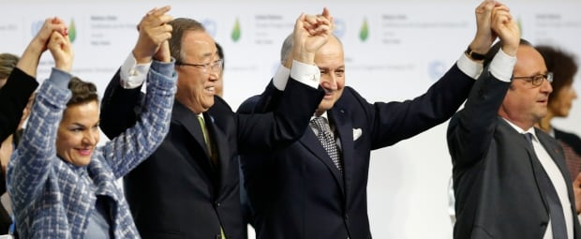
Technology under the Paris Agreement
  2015 – COP 21, Paris | Paris Agreement | Article 10
      Long-term vision on technology development and transfer
      Parties’ strengthening cooperative action on technology development and transfer
      Technology Mechanism to serve the Paris Agreement
      Acceleration, encouragement and enabling innovation, in particular early stages of technology, and related support
Notes:
The Paris Agreement provided a further important step in the evolution of technology under the climate process.
Article 10 establishes a long-term vision on the importance of fully realizing technology development and transfer in order to improve resilience to climate change and reduce greenhouse gas emissions.
It also emphasizes stronger cooperative action among Parties and recognizes the importance of accelerating, encouraging and enabling innovation.
Importantly, the Paris Agreement states that the Technology Mechanism established under the Convention shall also serve the Paris Agreement.
This means that the TEC and CTCN continue their respective policy and implementation roles, but their work also contributes directly to achieving the objectives of the Paris Agreement.
The Agreement therefore moves the technology discussion beyond individual technologies and places greater emphasis on cooperation, innovation, enabling environments and support for implementation.

Slide 5
Milestones on climate technology under the UNFCCC
2018: Technology Framework
2023: 1st Global Stocktake under the Paris Agreement, including on technology development and transfer
2023: Technology Mechanism Initiative on AI for Climate Action
2025: Revised functions of the CTCN (as of 2027)
2025: Belém Technology Implementation Programme
Notes:
Following the adoption of the Paris Agreement, several additional milestones have further shaped the technology architecture.
In 2018, Parties adopted the Technology Framework under Article 10 of the Paris Agreement. The Framework provides overarching guidance to the Technology Mechanism and focuses its work around areas such as innovation, implementation, enabling environments and capacity-building, collaboration and stakeholder engagement, and support.
In 2023, the first Global Stocktake considered progress and gaps in technology development and transfer. One important outcome was the establishment of a technology implementation programme, which Parties subsequently elaborated.
Also in 2023, the Technology Mechanism Initiative on AI for Climate Action was launched to explore the opportunities, challenges and risks associated with the use of artificial intelligence for climate action, particularly in developing countries.
Then, in 2025, Parties agreed on revised functions of the Climate Technology Centre, which will apply from 2027.
And importantly, COP 30 in Belém saw the adoption of the Belém Technology Implementation Programme.
These developments show an increasing focus within the UNFCCC process on moving from identifying technology needs towards implementation and delivery.

Slide 6
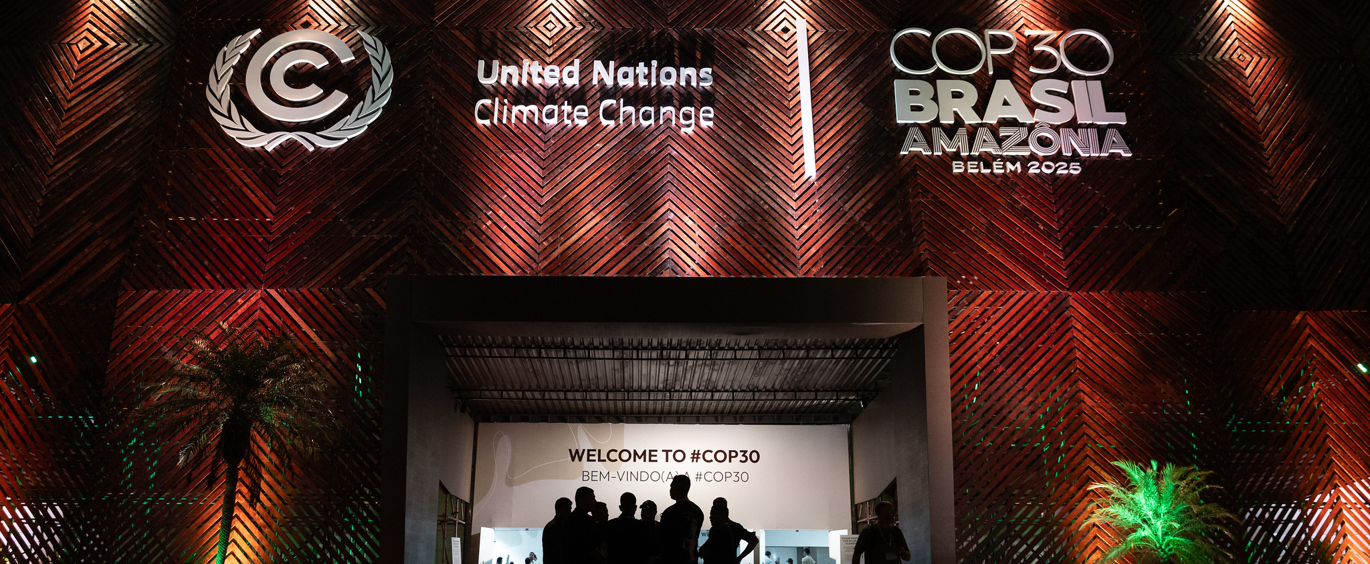
Belém Technology Implementation Programme
2025 – COP 30, Belém | Adoption of the Belém Technology Implementation Programme
  Addressing challenges encountered by developing countries at different stages of the technology cycle;
  Strengthening national systems of innovation and enabling environments;
  Supporting efforts to integrate climate-technology priorities into policies and programmes;
  Enhancing capacities to prepare and secure funding for climate-technology projects and fostering effective matchmaking to accelerate project implementation;
  Mobilizing both financial and non-financial resources to enhance support to the Technology Mechanism.
Notes:
I would like to spend a little more time on the Belém Technology Implementation Programme, because it represents an important recent development in the technology process.
The Programme was adopted at COP 30 in Belém in 2025, following the mandate that emerged from the first Global Stocktake.
Its overall purpose is to strengthen support for implementing technology priorities identified by developing countries and to address challenges identified through the first periodic assessment of the Technology Mechanism.
As shown on the slide, the Programme covers several practical areas.
These include addressing challenges encountered at different stages of the technology cycle; strengthening national systems of innovation and enabling environments; and supporting countries to integrate climate-technology priorities into policies, programmes and projects.
It also places strong emphasis on implementation capacity – including preparing project concepts and fundable projects, strengthening matchmaking and partnerships, and mobilizing both financial and non-financial resources.
This is particularly relevant for NDEs because many of these priorities originate at the national level, including through Technology Needs Assessments, Technology Action Plans, NDCs, NAPs and other national planning processes.
The Programme therefore provides an important opportunity to strengthen the link between identifying technology priorities and actually implementing them.

Slide 7
Technology in the UNFCCC intergovernmental process: 2025 and 2026
Convention
Art. 4.1 (c) and 4.5
Paris Agreement
Art. 10
Agenda Item | COP30/CMA7 (Nov 2025) and SB 64 (Jun 2026) | COP31/CMA8/SB65 (Nov 2026)
TEC-CTCN Joint Annual Report (JAR) | SB64 recommended draft decisions on JAR 2025. | Adopt draft decisions on JAR 2025; consider JAR 2026, including reporting on the BTIP; adopt decisions on JAR 2026.
TM-Financial Mechanism Linkages | SB64 recommended draft decision. | Adopt draft decision.
Host of the CTC | COP30 launched host selection; SB64 recommended UNEP as host; prepared elements of draft MOU. | Adopt decisions on the CTC hosting, including a MOU between COP, CMA and UNEP.
3rd CTCN Review |  | Consider report on the review, adopt decision on the review.
2nd PATM | SB64 initiated 2nd PATM. Interim report to be considered at SBI 66 (June 2027).
PSP | SB64 deferred consideration to SB65. | Consider PSP evaluation report; adopt decision on the way forward.
Technology Transfer Framework
Technology Framework
Technology Mechanism (TM)
Technology Executive Committee (TEC)
Climate Technology Centre and Network (CTCN)
Independent Review of the CTCN (CTCN Review)
Periodic Assessment of the Technology Mechanism (PATM)
Poznan Strategic Programme on Technology Transfer (PSP)
Belém Technology Implementation Programme (BTIP)
Notes:
This slide provides a snapshot of how technology currently appears within the UNFCCC intergovernmental process.
Technology development and transfer is supported by a number of interconnected arrangements under both the Convention and the Paris Agreement.
Guided by the Technology Transfer Framework under the Convention and the Technology Framework under the Paris Agreement, the Technology Mechanism delivers through its two complementary bodies, the TEC and CTCN. There are also two recurrent review processes in place, one under the Convention on the indepednent review of the effective implementation of the CTCN, and the other under the Paris Agreement on the effectiviness of and the adequacy of support provided to the Technology Mechanism.
Furthermore, there is the Poznan Strategic Programme on Technology Transfer under the Convention, and now since last November, the Belém Technology Implementation Programme under the Paris Agreement.
Now, if you look at the right side of this slide, you see an overview of how these different elements of the technology architecture are currently considered in the intergovernmental proceess.
At SB 64 in June, Parties advanced work on a number of issues, including the 2025 joint annual report of the TEC and CTCN, linkages between the Technology Mechanism and the Financial Mechanism, arrangements for the host of the Climate Technology Centre, and the second periodic assessment of the Technology Mechanism.
Looking towards COP 31, Parties will consider and possibly conclude on these processes. This includes consideration of the 2026 joint annual report, further decisions related to the hosting of the Climate Technology Centre, the third independent review of the CTCN, and the Poznan Strategic Programme.
For NDEs, the important message is that the technology architecture continues to evolve. The experiences and needs identified at country level help provide important practical context for this intergovernmental work.

Slide 8
Work of the UN Climate Change Secretariat on Technology
Intergovernmental process support
Negotiations, pre- and post-session documents, submissions, synthesis, reviews
Technology Mechanism
support
TEC, collaboration with CTCN and partners,
TM Initiative on AI
Technology-related planning/reporting tools and data
TNA/TAP repository, synthesis reports on NDCs and BTRs
Knowledge management
TT:CLEAR
Cross-cutting
Engagement in other UN processes, communications and outreach etc.
https://unfccc.int/ttclear/negotiations
https://unfccc.int/ttclear/tec
https://unfccc.int/ttclear/tna
Notes:
Behind these intergovernmental arrangements, the UN Climate Change secretariat provides a range of support on technology development and transfer.
One area is support to the intergovernmental process. This includes providing procedural support to presiding officers of the negotiations and preparing pre- and post-session documentation.
Another area is support to the Technology Mechanism. This includes, in particular, supporting the work of the TEC, but also collaboration between the TEC and the CTCN and other partners as well as initiatives such as the Technology Mechanism Initiative on AI for Climate Action.
The secretariat also supports works on technology-related planning, reporting and data processes. For example, it maintains the TNA and TAP repository and undertakes analytical work related to technology information contained in national reports and submissions.
Another important function is knowledge management. TT:CLEAR serves as the main UNFCCC platform for information on climate technology, bringing together information on negotiations, the TEC, TNAs, publications, events and other resources.
Finally, there is a cross-cutting role involving engagement with other UN processes, communications, outreach and partnerships.
Together, these areas of work help connect the intergovernmental process, the Technology Mechanism and national-level technology action.

Slide 9

https://unfccc.int/ttclear
Pauline Namutebi
Associate Programme Officer, Technology Sub-Division, UNFCCC
Notes:
That brings me to the end of my presentation.
The key message I would like to leave with you with is that technology development and transfer has been a key part of the UNFCCC process since the Convention was adopted and that the technology architecture has continued to evolve in response to countries’ needs and the growing focus on implementation.
NDEs are central to this architecture. You provide an important connection between national technology priorities and the work taking place internationally through the Technology Mechanism and the wider UNFCCC process.
Throughout this Forum, we hope to hear about your experiences, priorities and challenges, and to explore how the different elements of the technology architecture can better support implementation in your countries.
You can find further information, publications and resources on TT:CLEAR by scanning the QR code shown on the screen.
Thank you very much.

