Slide 1

Introduction to the Technology Executive Committee (TEC)
Mandate, Activities and Outlook for 2026-2027
Eastern Europe NDE Forum | 7 - 9 September 2026 | Baku, Azerbaijan
Stig Svenningsen
Member, Technology Executive Committee
Notes:
Greetings colleagues. I am speaking on behalf of the UNFCCC Technology Executive Committee, in short, the TEC. I am going to briefly present the mandate of the TEC as well as our ongoing work and latest outputs that may be of interest to you. I will also provide you with an outlook of what lies ahead for the rest of this year and next year.

Slide 2
TEC Mandate
1
Provide an overview of countries’ climate technology needs and analyze policy and technical issues related to climate technology development and transfer
2
Recommend actions to promote climate technology development and transfer
3
Recommend guidance on climate technology policies and programs
To enhance climate technology development and transfer
4
Promote and facilitate collaboration between climate technology stakeholders
5
Recommend actions to address barriers to climate technology development and transfer
6
Seek cooperation with climate technology stakeholders and promote coherence across technology activities
7
Catalyze the development and use of climate technology roadmaps and action plans
Notes:
The TEC’s overall role is to enhance climate technology development and transfer. Its seven functions cover the full policy cycle: understanding countries’ technology needs, analyzing policy and technical issues, recommending actions and guidance, and helping address barriers that may slow technology development and transfer.
Another important part of our mandate is collaboration. The TEC does not work in isolation. It promotes and facilitates collaboration among climate technology stakeholders, seeks cooperation with relevant actors, and works to promote coherence across technology activities.
The mandate is also implementation-oriented. The TEC is expected to catalyze the development and use of climate technology road maps and action plans. This is particularly relevant for NDEs to move national technology priorities, including those identified through Technology Needs Assessments and Technology Action Plans, from planning towards implementation.
In carrying out these functions, the TEC, as the policy arm of the Technology Mechanism serves both the Convention and the Paris Agreement

Slide 3
TEC rolling workplan 2023-2027
As part of the joint work programme of the Technology Mechanism, the TEC rolling workplan for 2023-2027 delivers across four workstreams:
Highlights from the work of the TEC on adaptation: early warning systems, water-energy-food systems, ocean-focused climate action.
Workstream 1: NSI, Collaborative RD&D & General-Purpose Technologies
Workstream 2: TNAs & technology planning tools to support NDC implementation
Workstream 3: Transformative & innovative solutions
Workstream 4: Collaboration & engagement with other UNFCCC processes/bodies & other UN agencies
Highlights from the work of the TEC on mitigation: industrial decarbonization, urban mobility, buildings and infrastructure.
Highlights from the work of the TEC on cross-cutting matters: National systems of innovation (NSI), artificial intelligence, technology needs assessments (TNAs), gender
Highlights from the work of the TEC on relevant processes under the UNFCCC: NDCs, NAPs, LT-LEDS, linkage with the Financial Mechanism
Notes:
The current workplan of the TEC is structured around four workstreams:
Workstream 1 - focused on innovation. Activities under this workstream include the work on national systems of innovation; incubators and accelerators for climate technologies in developing countries; research, development and demonstration, early warning systems and digital technologies, including artificial intelligence
Workstream 2 – focused on technology needs assessments & technology planning tools to support NDC implementation
Workstream 3 – focused on transformative & innovative solutions. Activities under this workstream include the work on water-energy-food systems, industrial decarbonization, and oceans.
Workstream 4 - focused on collaboration & engagement with other UNFCCC processes/bodies & other UN agencies.
Activities of the TEC under its rolling workplan cover issues related to both climate mitigation and adaptation technologies in priority sectors for climate action, as well as cross-cutting issues such as innovation, digital technologies, TNA and gender mainstreaming.
In addition, the TEC contributes to other processes and the work of constituted bodies under the UNFCCC and Paris Agreement, for example, the committee continually engages with the Paris Committee on Capacity-building, as well with the Standing Committee on Finance regarding guidance to the GEF and GCF.

Slide 4
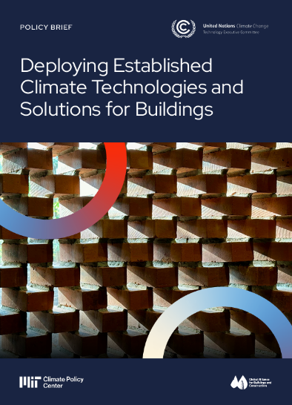





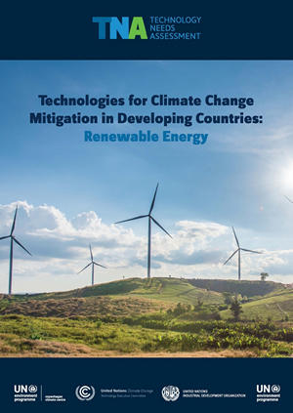
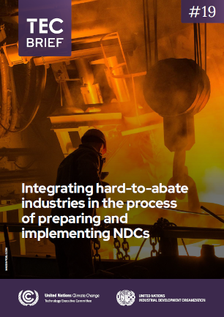
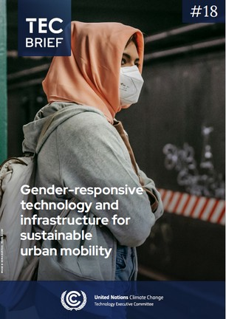
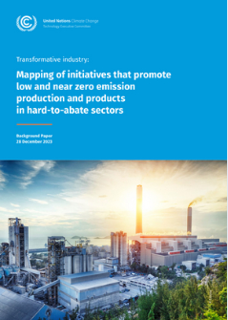
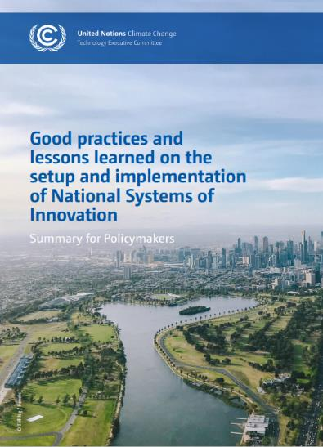

Latest TEC publications
+ more
Explore more: publications https://unfccc.int/ttclear/tec/documents.html
Explore technology events: https://unfccc.int/ttclear/events/index.html
Notes:
This is an overview of the latest TEC publications. As you can see, this covers a range of different knowledge products, such as policy briefs, technical papers, guidebooks, and importantly, policy recommendations to Parties to the UNFCCC and the Paris Agreement.
You could also see the wide range of thematic issues that the TEC works on, from industry to agrifood systems to the application of artificial intelligence for climate action in developing countries.
The TEC uses different events and digital channels to disseminate its policy work. To find out more about TEC publications and technology development and transfer under the UNFCCC, visit TT:CLEAR webpages included on this slide.

Slide 5



UNFCCC Technology Mechanism Initiative on AI for Climate Action
Objective: Launched in 2023, the initiative explores opportunities, challenges and risks of AI for advancing and scaling up transformative climate action in developing countries, with a focus on LDCs and SIDS (Decisions 1/CMA.5, 14/CMA.5 and 9/CP.28).
Highlights:
Technology Mechanism AI for Climate Action Award
Technology Mechanism AI Climate Application Hub, hosted by the Digital Public Goods Alliance
TEC AI for Climate Action Forum
UNFCCC COP Masterclasses on AI
Knowledge products
Policy recommendations
Explore more: https://unfccc.int/ttclear/artificial_intelligence
Notes:
The TEC also leads and engages in global initiatives on climate technologies. An important highlight is the collaboration of the TEC and CTCN in the context of the Technology Mechanism Initiative on AI for Climate Action, that was launched in 2023 and mandated by Parties. The Korea International Cooperation Agency (KOICA) has partnered with the TEC in support of this initiative.
Some highlights from the activities under the initiative include a global open-source AI competition that we held in 2024, 2025, and is currently underway for this year. In 2025, the award went to a team from Lao PDR for an AI-driven irrigation monitoring service selected among 634 entries, and in 2024, the award went to a team from Trinidad and Tobago for an AI Driven Climate Resilience Platform for SIDS, selected among 114 entries. We look forward to working with this year’s cohort of innovators, with the winner to be announced at the TEC AI for Climate Action Forum in Cambodia next month.
This year in April we also launched the AI Climate Application Hub, together with the CTCN and the Digital Public Goods Alliance. The platform provides open-source AI use-cases and dataset to facilitate AI-powered climate solutions.
Last October we also organized the first TEC AI for Climate Action Forum, convening more than 300 participants from around the world in Dar es Salaam, Tanzania, to discuss opportunities, risks and challenges of AI-powered climate change adaptation and mitigation solutions. This year this global forum will be held in Phnom Penh, Cambodia from 13-14 October.
The TEC also utilizes leading conferences and events to highlight its ongoing work under the initiative, including at the AI for Good Summits. A flagship event during the COP 30, in collaboration with the CTCN and PCCB was a masterclass on AI and energy systems. We will continue this work this year at COP 31, with a masterclass on AI in water-energy-food nexus.
The TEC have also worked on a number of knowledge products under the initiative, including a technical paper published last year, which informed TEC policy recommendations to Parties on this topic.
The work under the initiative continues to engage technology experts and practitioners across regions. I invite you to have a look at the initiative’s webpage on TT:CLEAR and engage in various activities in this context.

Slide 6
What to expect in 2026-2027
Thematic areas of work:
Set up and implementation of NSI
RD&D on energy storage
Incubators and accelerators for climate technologies in developing countries
Community-based early warning systems
NDCs and digital technologies
AI for climate action, with a focus on LDCs and SIDS
Support for TNA implementation
Scaling up climate technology solutions in agrifood system
Leveraging data to accelerate financing for climate technologies in buildings and infrastructure
Industrial decarbonization
Belém Technology Implementation Programme (BTIP)
Incorporation of elements of the BTIP in the current and next TEC rolling workplan
Determination of the topic and organization of the first global dialogue under the BTIP
Collaboration with the CTCN on regional dialogues under the BTIP
Global Stocktake under the Paris Agreement
TEC inputs to the second global stocktake under the Paris Agreement
Notes:
Looking ahead to the remainder of the current TEC rolling workplan, here are a few highlights from the work of the TEC:
Regarding the policy and technical work under the TEC rolling workplan, we will continue working on a number of thematic areas, including NSI, incubators and accelerators, early warning systems, digital technologies, TNAs, building and infrastructure and industrial decarbonization.
The TEC also conducts its work in response to the recent guidance from Parties. For example, at its upcoming meeting in September, the TEC will determine the topic of the first global in-session dialogue under the Belém TIP to take place in 2027, informed by submissions by Parties and stakeholders.

Slide 7
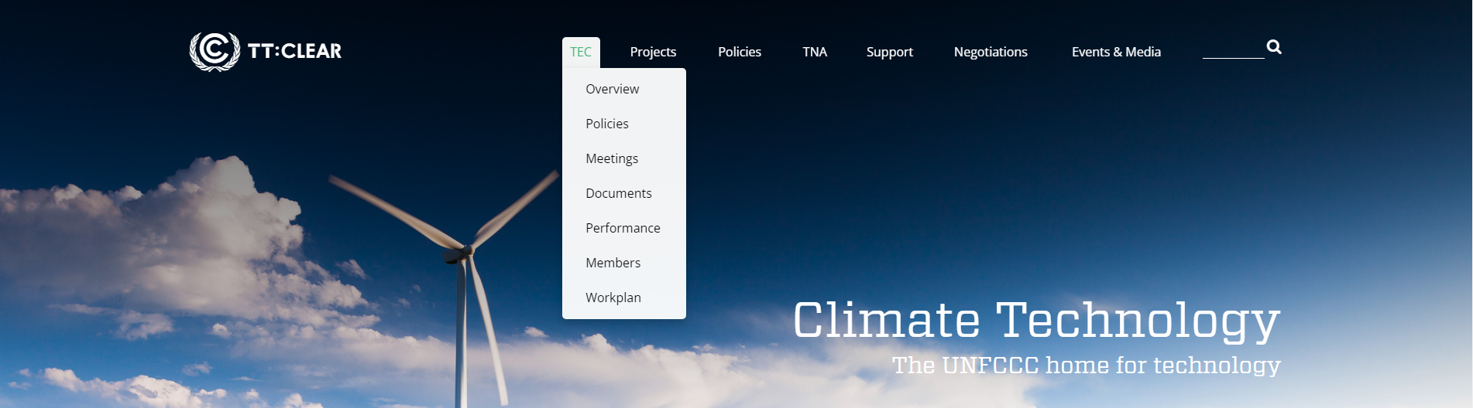


Stay informed
UNFCCC website:
Follow the latest updates on technology-related matters on TT:CLEAR – publications, events, initiatives, open calls and more > https://unfccc.int/ttclear
UN Climate Change Technology Group on Linkedin:
Exchange latest updates and information with 3000+ members from the global community of climate technology #ClimateTech #TechnologyMechanism #TEC
> https://www.linkedin.com/groups/14126588/
Mark your calendars in 2026
15-18 September: TEC 33 (broadcast online)
9-20 November: Technology events @ COP31
Notes:
If you are interested to stay informed about the work of the TEC, in addition to following the TEC meetings that I just mentioned and are always livestreamed, you could find out more about the ongoing work through TT:CLEAR, and on social media through the UN Climate Change Technology Group on Linkedin.
The TEC, together with the CTCN, also hosts side-events at the margins of the UN Climate Change conferences. We encourage you to join these Technology Mechanism events to engage with the two bodies and the broader community of climate technology.

Slide 8
Stay engaged – As NDEs…
Consider disseminating the work of the TEC among policy-focused actors in your institutions and networks: for example when engaging with relevant line ministries, sub-national governments, technology practitioners, communities of practice, academia, youth and innovation actors
Consider applying TEC policy recommendations in your context and share your insights, results and lessons learned with the TEC, for example through TEC surveys and questionnaires
Provide us with feedback through the NDE surveys; and via email to the TEC inbox all-year-round
Share examples of your work with the TEC through its activities, events and dialogues
Contact us: tec@unfccc.int
Notes:
Finally, on the point about engagement, I would like to highlight other avenues you could engage with the work of the TEC, including applying TEC policy recommendations in your context, disseminating TEC’s work in your institutions, and sharing examples of your work with the TEC.
Sharing TEC policy papers, publications and guidebooks with line ministries, sub-national governments, academia, practitioners, and innovation actors in your countries is an effective way to bring the results of work under the UNFCCC process to the national, sectoral and local levels.
It is equally important for us to hear from you on the learnings, priorities, and challenges you are facing, so we could align our work accordingly to address your practical needs. Participating in questionnaires and surveys and communicating with the TEC secretariat, including at this forum, are effective ways to engage with and inform the work of the committee.
In addition to direct engagement in the technical work of the TEC, NDEs’ inputs inform and enrich the monitoring and evaluation of the results of the Technology Mechanism’s work.
Participation in TEC meetings, in-person or online is also a good way to not only keep abreast of the latest development in the TEC work.
With that, I would like to conclude this presentation. On behalf of the TEC, I thank you for your attention and wish you fruitful exchanges in the following days.

