Slide 1

CTCN 28th Advisory Board Meeting
Work of the Adaptation Committee
Bonn-Germany
18-23 April 2026
UNFCCC Adaptation Committee

Slide 2
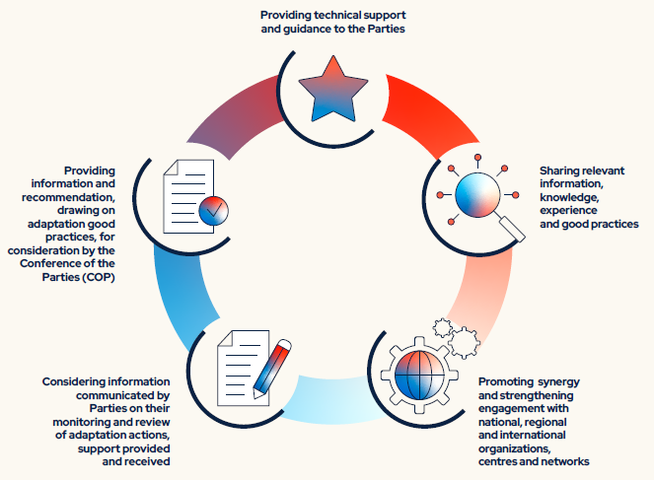

Adaptation Committee
UNFCCC Adaptation Committee
Notes:
Thank you very much for inviting the Adaptation Committee to participate in your meeting. It is my pleasure to represent that Committee here today.
For those of you who may not be familiar with the Adaptation Committee, we were established in 2010 and are the principal body under the UNFCCC providing expert guidance on adaptation and ensuring that adaptation is addressed coherently under the UNFCCC process and in line with the Paris Agreement.
Our core functions include:
Providing technical support and guidance to Parties
Promoting synergy and strengthening engagement with national, regional and international organizations, centers and networks
Sharing relevant information, knowledge, experience and good practices
Considering information communicated by Parties on their monitoring and review of adaptation actions, support provided and received; and
Providing information and recommendations, drawing on adaptation good practices for consideration by the Conference of Parties (COP)
The AC is in regular contact with the other adaptation-related constituted bodies and processes to discuss collaborative opportunities and is ready to engage and looks forward to collaborating with the CTCN following any specific requests for input or joint work on these activities.

Slide 3
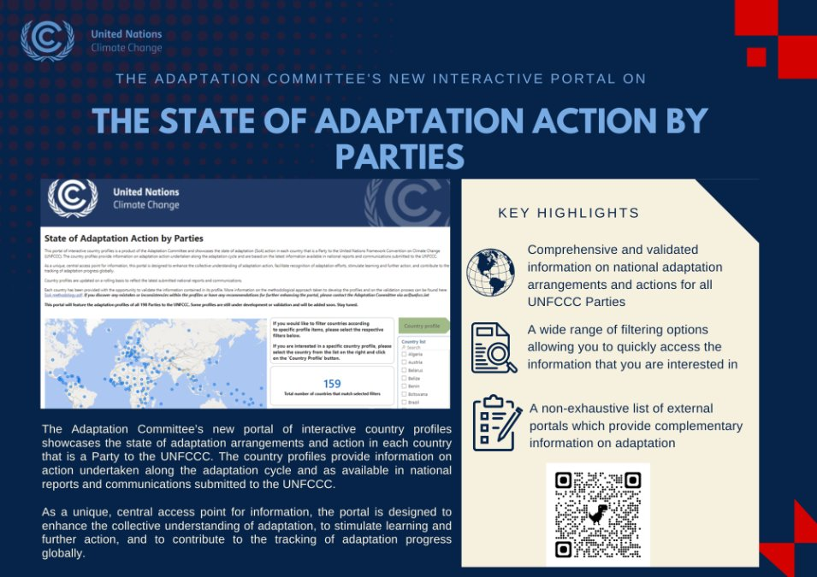
Recent work with linkages to technology
UNFCCC Adaptation Committee
Notes:
The AC recently updated its interactive State of Adaptation Action by Parties (SoA) Portal, launched in 2024. The portal provides country profiles for all 198 Parties to the UNFCCC, based exclusively on information contained in national reports and communications submitted by Parties to the UNFCCC and validated by the respective Party.
At its 30th meeting (AC 30), the AC adopted the 2026 State of Adaptation Action Synthesis Report, the first in a planned series of regular synthesis reports drawing on information available through the portal. The series aims to provide succinct and user-friendly information on adaptation action and progress within the evolving adaptation architecture under the Convention and the Paris Agreement.
Drawing on information available in the SoA Portal as of 31 May 2026, the first synthesis report highlights global approaches and country examples to support learning and understanding of adaptation action and progress, including in the context of the global goal on adaptation and the UAE Framework for Global Climate Resilience.
For the CTCN, the SoA Portal and synthesis report can provide avenues to contextualize country-reported adaptation priorities, approaches and implementation needs relevant to technology-related support and engagement.

Slide 4
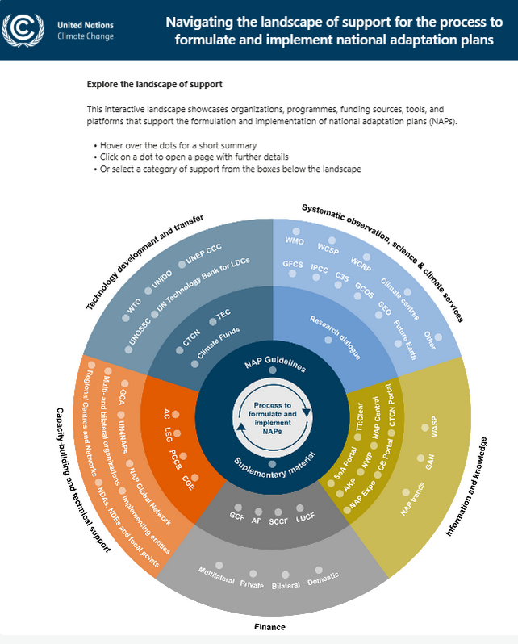

UNFCCC Adaptation Committee
Notes:
The AC has completed the first phase of updating its online tool for navigating the landscape of support to formulate and implement NAPs.
Developed in 2022, the tool supports the AC's work to provide technical support and guidance to Parties on adaptation, including on technology development and transfer.
The tool was developed with contributions from the AC's NAP task force, which supports the AC's work on NAP-related issues and includes representatives of relevant constituted bodies under the UNFCCC, including the TEC, as well as representatives of the GCF, GEF and Adaptation Fund.
The next phase will restructure the tool, broaden the types of support covered, incorporate support relevant to implementation of the UAE Framework and its targets, and introduce additional interactive features tailored to different user needs. The AC agreed to collaborate with external experts for the next phase of updating the tool including by inviting the submission of additional support opportunities for which the AC will reach out to CTCN.

Slide 5
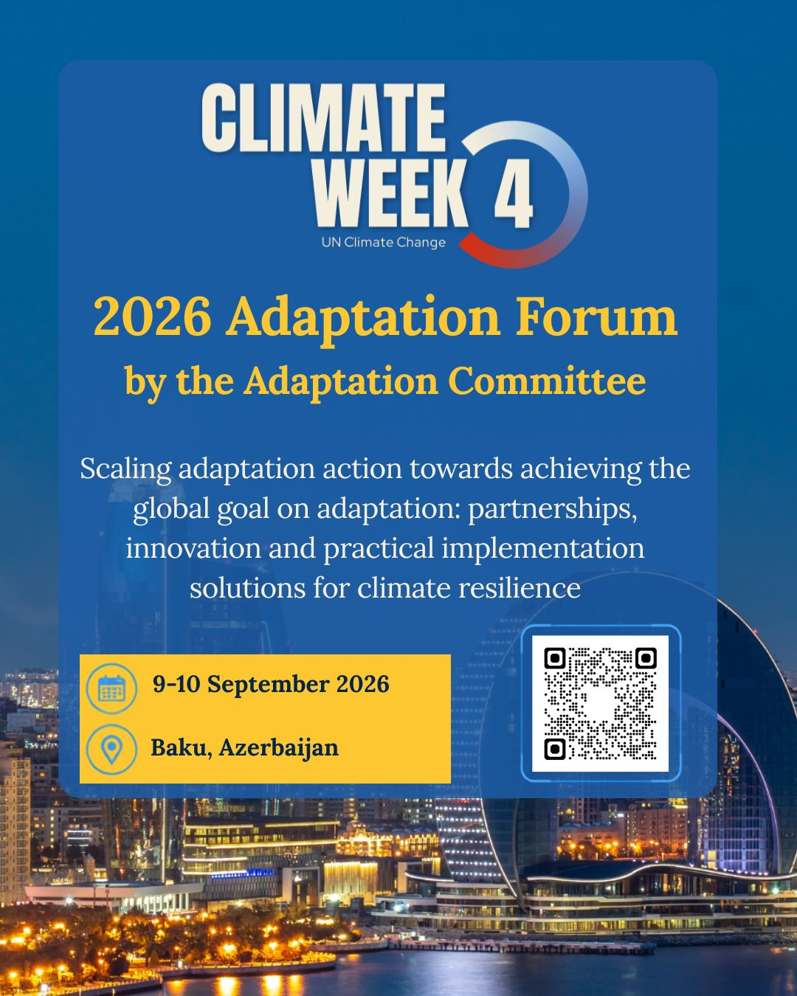
2026 Adaptation Forum
Convened by the Adaptation Committee on 9–10 September 2026 in Baku, Azerbaijan, as part of the Climate Week 4 Implementation Forum.
Theme: Scaling adaptation action towards achieving the global goal on adaptation: partnerships, innovation and practical implementation solutions for climate resilience.
Session 4 of the 2026 Adaptation Forum on future pathways and emerging frontiers explored foresight, scenario planning, climate intelligence, AI and digital innovation for adaptation planning and implementation.
UNFCCC Adaptation Committee
Notes:
The Adaptation Committee convened the 2026 Adaptation Forum on 9–10 September 2026 in Baku, Azerbaijan, as part of the Implementation Forum of Climate Week 4. The Forum was held under the theme “Scaling adaptation action towards achieving the global goal on adaptation: partnerships, innovation and practical implementation solutions for climate resilience.”
The Forum focused on accelerating adaptation implementation, practical and scalable solutions, innovation, partnerships and future adaptation priorities.
Session 4: Future pathways for adaptation and emerging frontiers focused on future-ready adaptation systems, long-term adaptation pathways and emerging tools, including foresight, scenario planning, climate intelligence, AI and digital innovation.
Discussions highlighted the practical use of emerging tools for scenario planning, early warning, climate-risk information and more targeted adaptation decision-making, while emphasizing the importance of local knowledge, institutional capacity and adequate support for implementation.

Slide 6

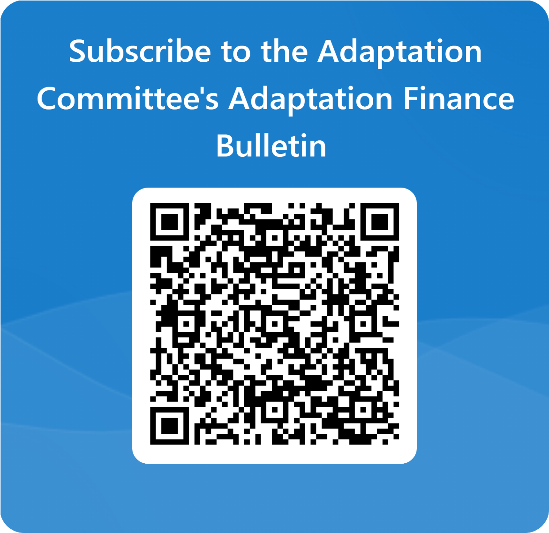
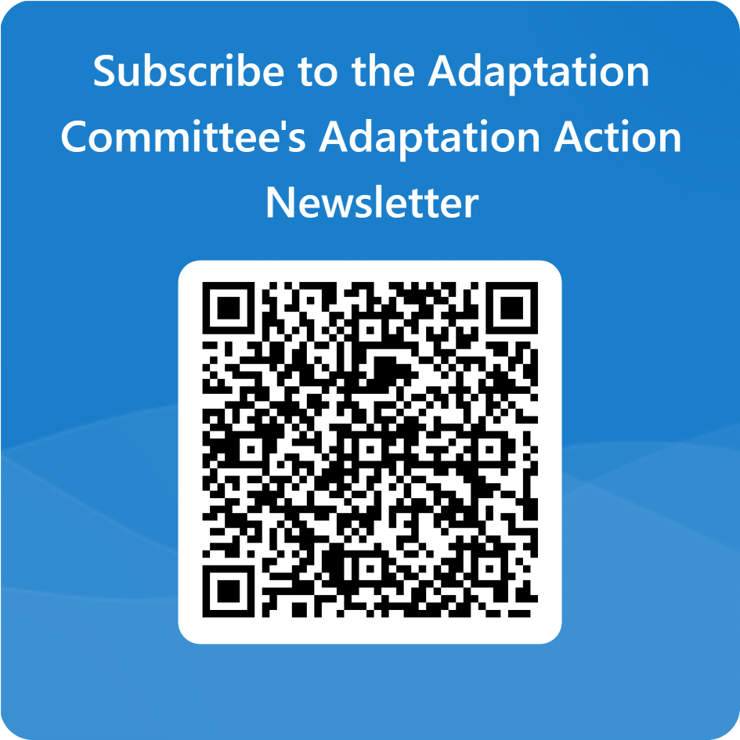
Newsletters
UNFCCC Adaptation Committee
Notes:
The AC regularly disseminates newsletters including the Adaptation Action newsletter and the Adaptation Finance Bulletin. The CTCN is invited to contribute relevant information and examples on adaptation technologies for possible dissemination through AC communication products, including the Adaptation Action newsletter.

Slide 7
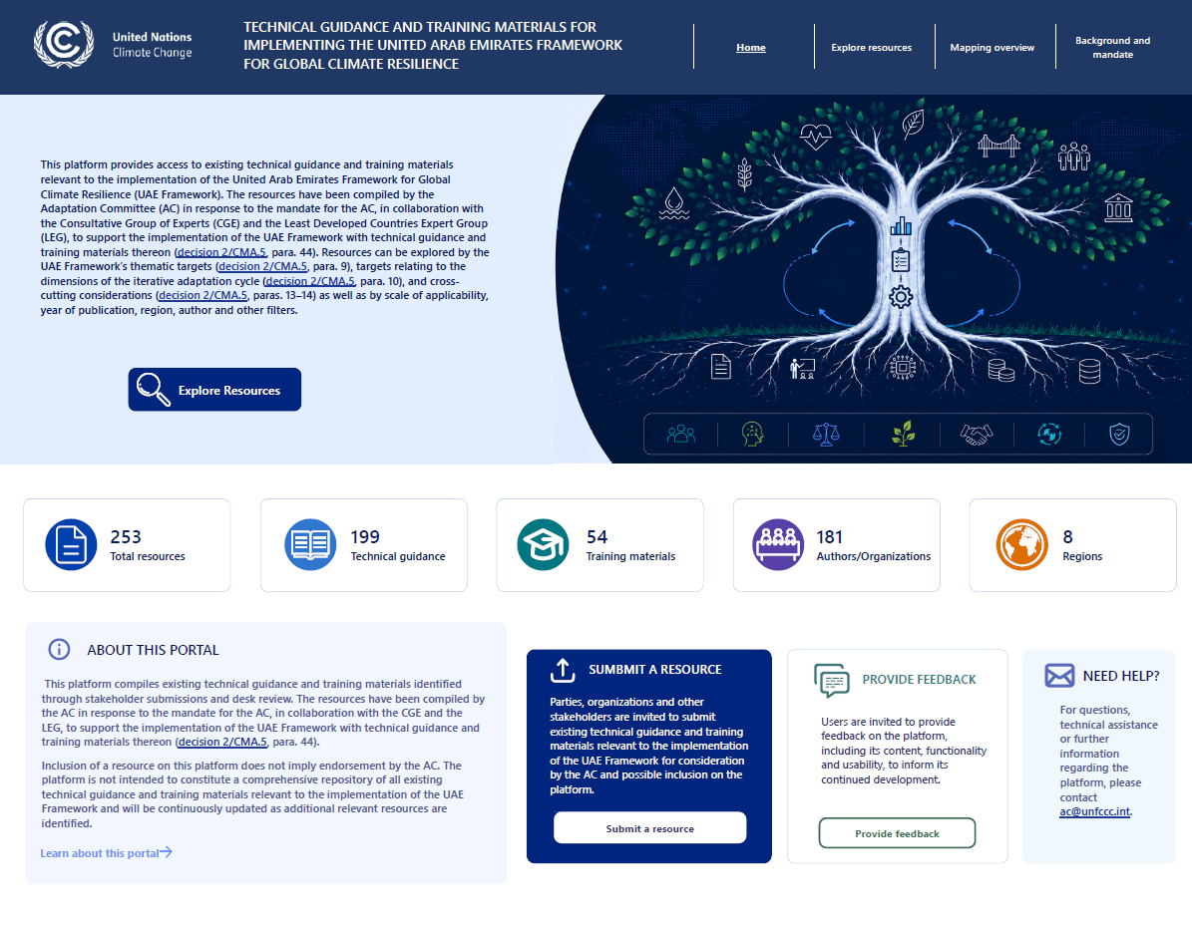
Upcoming digital platform
UNFCCC Adaptation Committee
Notes:
The AC is developing an online platform to facilitate access to existing technical guidance and training materials relevant to implementation of the UAE Framework for Global Climate Resilience.
This work responds to decision 2/CMA.5, paragraph 44, under which the AC, in collaboration with the CGE and the LEG, is invited to support implementation of the UAE Framework through technical guidance and training materials thereon.
The resource is intended to improve the accessibility and navigation of relevant existing materials and to support their practical use by Parties and other adaptation practitioners.

Slide 8
2026 synthesis report on the recognition of adaptation efforts of developing country Parties (upcoming)
The upcoming synthesis report focuses on to recognize and synthesize lessons learned and good practices from developing country Parties in establishing and strengthening integrated knowledge, science, technology and data systems to advance adaptation action and reporting.
The report follows the four elements of the iterative adaptation cycle: risk, impact and vulnerability assessment; adaptive capacity assessment; adaptation planning; implementation; and monitoring, evaluation and learning.
The report examines how developing countries have established and used knowledge, science, technology and data systems for the implementation of these elements and which gaps and challenges remain.
UNFCCC Adaptation Committee
Notes:
Another area of interest for CTCN is the upcoming 2026 synthesis report on the recognition of adaptation efforts of developing country Parties.
The upcoming synthesis report focuses on to recognize and synthesize lessons learned and good practices from developing country Parties in establishing and strengthening integrated knowledge, science, technology and data systems to advance adaptation action and reporting.
The report follows the four elements of the iterative adaptation cycle: risk, impact and vulnerability assessment; adaptive capacity assessment; adaptation planning; implementation; and monitoring, evaluation and learning.
The report examines how developing countries have established and used knowledge, science, technology and data systems for the implementation of these elements and which gaps and challenges remain.
CTCN is invited to share lessons and examples on emerging adaptation technologies and on integrated technology, knowledge and data systems that could inform relevant AC knowledge products.

Slide 9
Thank you!
UNFCCC Adaptation Committee
Notes:
The AC welcomes the collaboration with the TEC and CTCN and is looking forward to further cooperation throughout 2026 and beyond!

