Slide 1
Outcomes of the Thirty-eighth
Meeting of the SCF
Diann Black-Layne
Standing Committee on Finance
26th Advisory Board meeting of the UN Climate Technology Centre & Network
17 September 2025

Slide 2
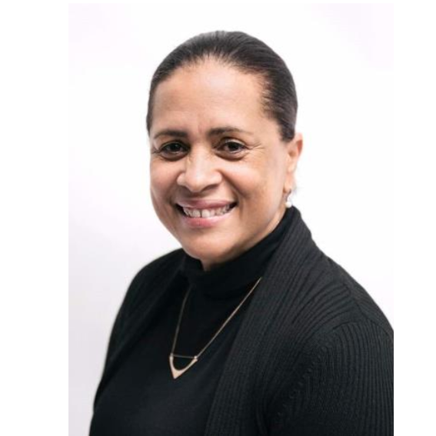
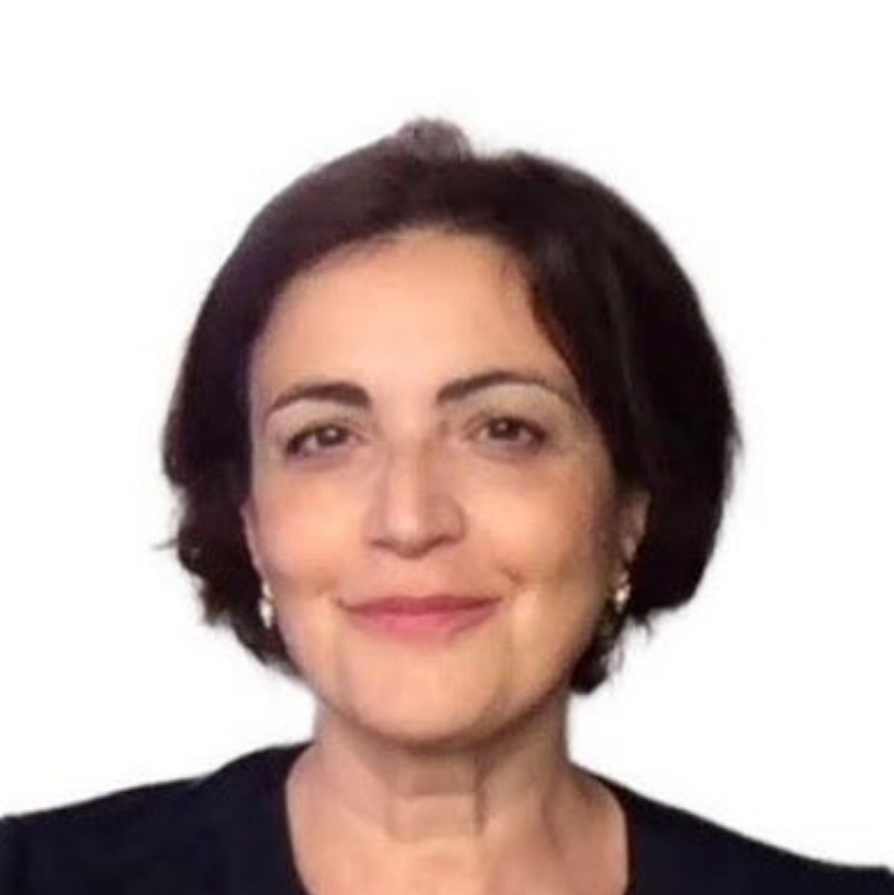

Co-chairs and focal points in 2025
At SCF 36, Committee elected its co-chairs and nominated focal points for other constituted bodies and thematic areas
Co-chairs
SCF focal points for technology
  Diann Black-Layne (Antigua and Barbuda)
  Apollonia Miola (European Union)
  Diann Black-Layne
  Clara Schultz (Sweden)

Slide 3
Outcomes of SCF 38 in a glance
Key highlights of the 2025 SCF Forum on “Accelerating climate action and resilience through financing for sustainable food systems and agriculture”
Forum of the Standing Committee on Finance
  Possible scope of the 2026 SCF Forum on
  “Financing Climate Action in Water Systems and Ocean”
  Possible theme of the 2027 SCF Forum
Draft guidance to the Operating Entities of the Financial Mechanism

Slide 4
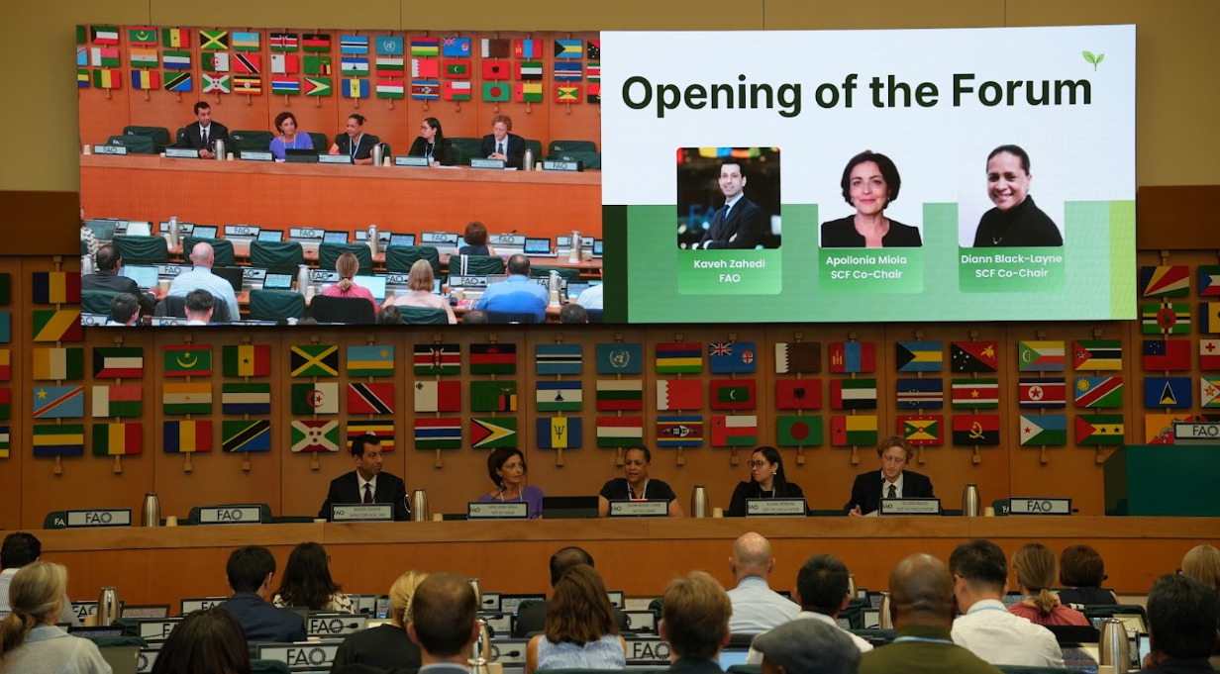
SCF Forum on accelerating climate action and resilience through financing for sustainable food systems and agriculture
The Forum explored the nexus of climate finance, agriculture and food systems by bringing together diverse stakeholders to enhance access to finance, promote sustainable practices, and strengthen resilience for long-term food security
Participants emphasized aligning climate finance with NDCs, NAPs, and agricultural policies, strengthening ministerial coordination, improving local access to finance, and valuing traditional knowledge, data, and inclusive approaches for resilient food systems
Outcomes will be summarized by the SCF and reported to COP 30/CMA 7
Co-facilitators: Oliver Gales (Australia) and Elena Cristina Pereira Colindres (Honduras)
2025 SCF Forum, Rome, Italy,
8-9 September 2025Tanzania

Slide 5
Themes for the 2026 and 2027 SCF Forum
2026 SCF Forum
Members discussed possible scope for the 2026 SCF Forum on “Financing Climate Action in Water Systems and Ocean” to be included in the SCF38 meeting report.
SCF agreed
On the intersessional activities, including:
(1) A call for inputs on information and case studies relating to the topic and possible sub-themes of the 2026 SCF Forum by 31 January 2026;
(2) Outreach to relevant institutions by the co-facilitators; and
(3) Engagement of SCF members in fundraising activities.

Slide 6
Themes for the 2026 and 2027 SCF Forum
2027 SCF Forum
SCF members discussed possible themes for the 2027 Forum to be included in the SCF38 meeting report.
SCF agreed:
To continue its consideration of the theme for the 2027 SCF Forum at SCF 39 on the basis of the discussions at the 38th meeting and further intersessional work by co-facilitators.
Request the co-facilitators to continue to work intersessionally to narrow-down the options for the 2027 Forum theme for consideration at SCF 39.

Slide 7
Draft guidance to the Operating Entities of the Financial Mechanism
The SCF’s approach is to cluster issues in order to streamline discussions, while maintaining key positions and nuances so that Parties’ priorities are fully reflected. This process is not a negotiation, but rather a means to enhance clarity, identify commonalities, and organize inputs in a structured manner.
SCF agreed to:
Include the draft guidance to the operating entities and the explanatory note into the annual report of the SCF for Parties’ consideration at COP 30 / CMA 7.
Co-facilitators: Tamim Al-Othimin (Saudi Arabia) (replacement for Ali Waqas (Pakistan) at SCF38) and Karima Oustadi (Austria)

Slide 8
Linkages
Technology in SCF deliberations
The SCF consistently recognizes technology as an integral component of climate finance. Discussions highlight how finance can enable the deployment, transfer, and scaling-up of climate technologies, particularly in developing countries
SCF Forum themes
Include technology dimensions (e.g. financing for sustainable food systems and agriculture, deployment of innovative solutions)
Draft guidance
The draft guidance includes technology elements primarily provided by the TEC. Includes elements such as enhanced support for technology needs identified by countries, strengthening enabling environments for technology transfer and improving coordination with the Technology Mechanism.
Overall linkage
These efforts underscore the synergies between the SCF and the CTCN. By aligning finance and technology, both bodies can better support countries in achieving their NDCs and adaptation priorities.

Slide 9

Thank you for your attention
Visit the SCF webpage for more information.

