Slide 1






Presentation of Architectural Design of the Hydroponic Farm
To the
Stakeholder Working Group (SWG)
For the Technical Assistance (TA) on
Empowering Communities with Sustainable Agricultural Systems; Piloting a Small-Scale Hydroponics System (EMSAS-Hydroponics)
in Kubau LGA of Kaduna State, Nigeria.
Thursday 10th October, 2024. 1:30 pm (Nigerian time)

Slide 2
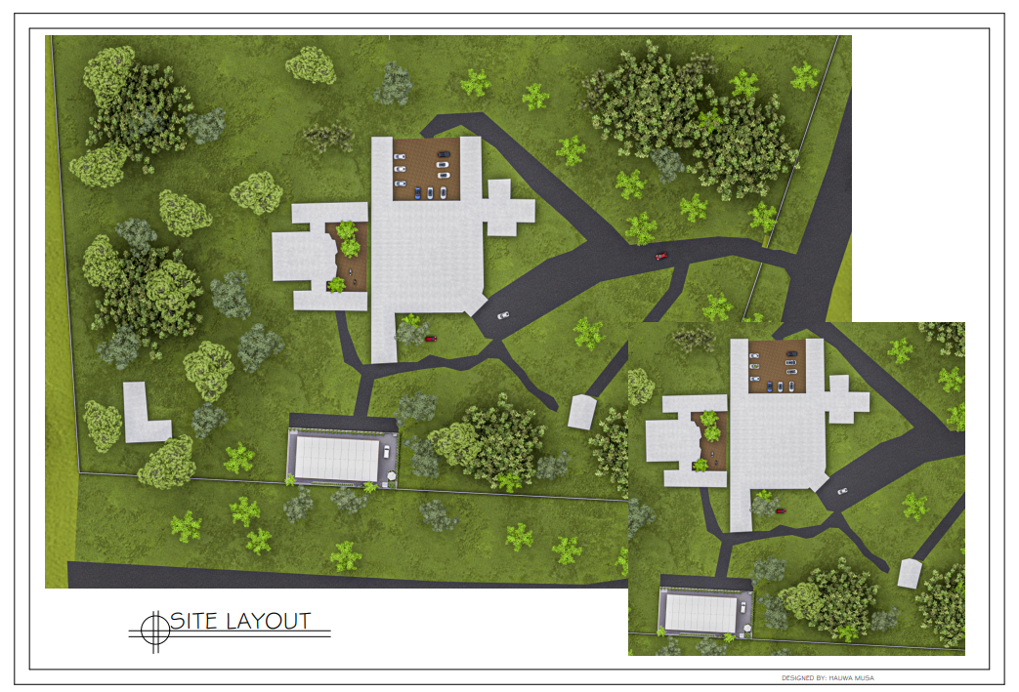

Slide 3
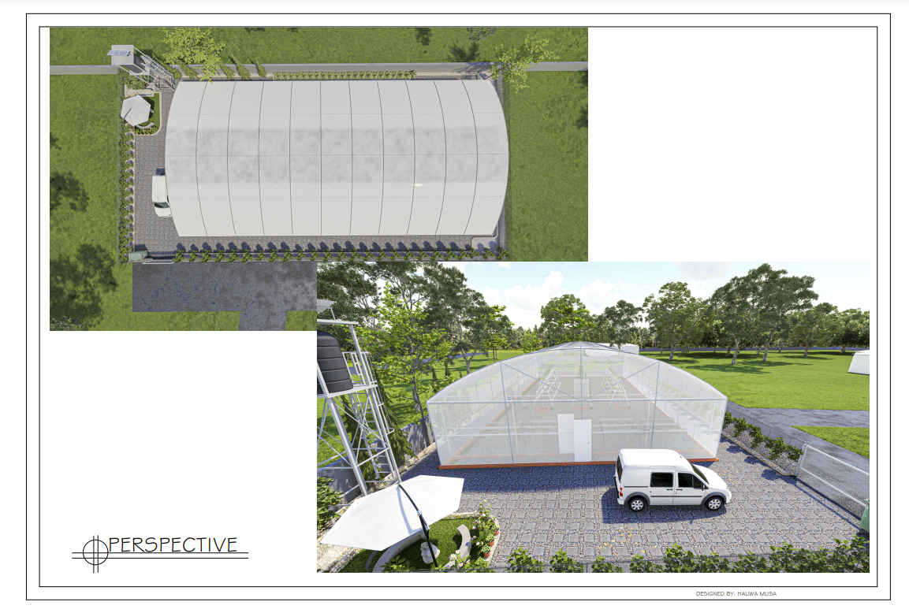

Slide 4
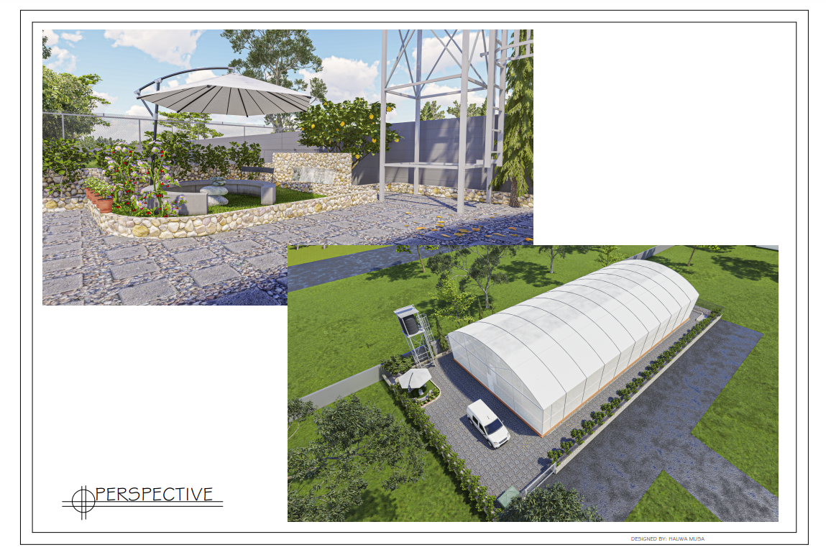

Slide 5
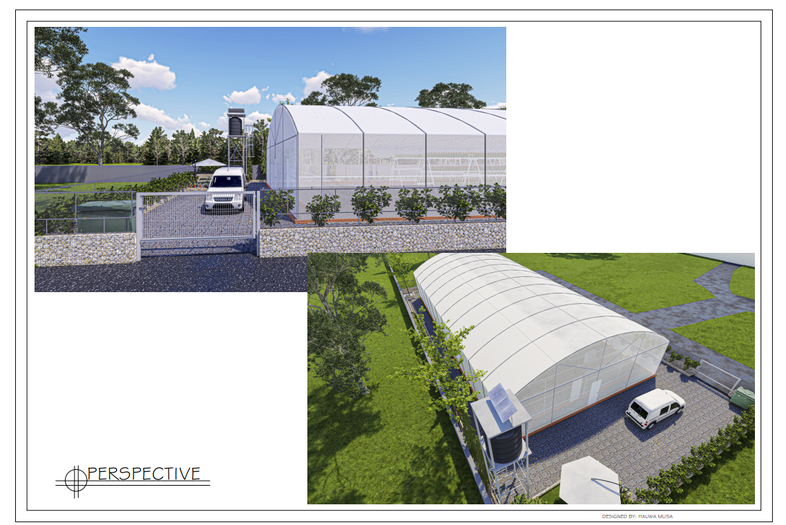

Slide 6
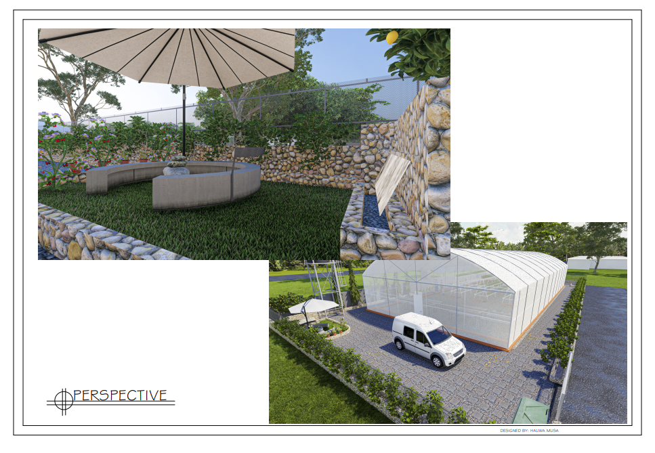

Slide 7
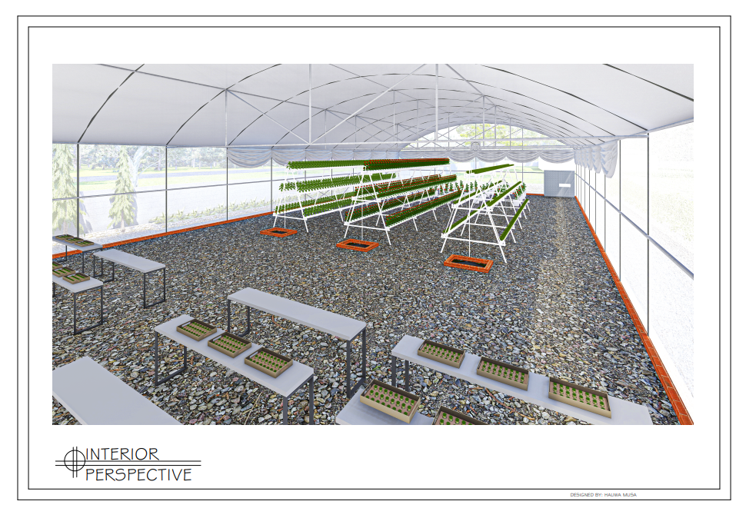

Slide 8
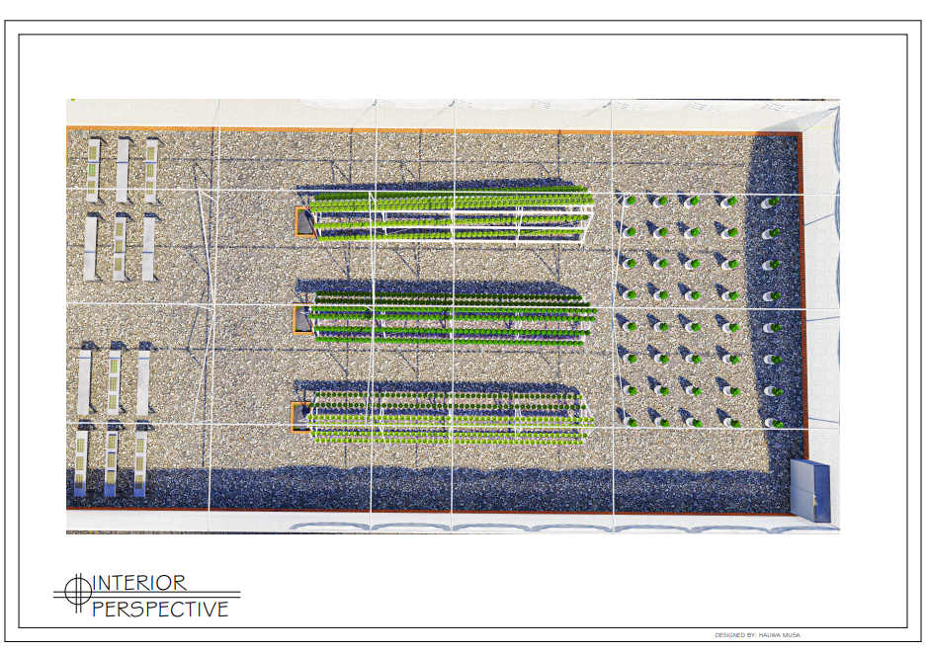

Slide 9
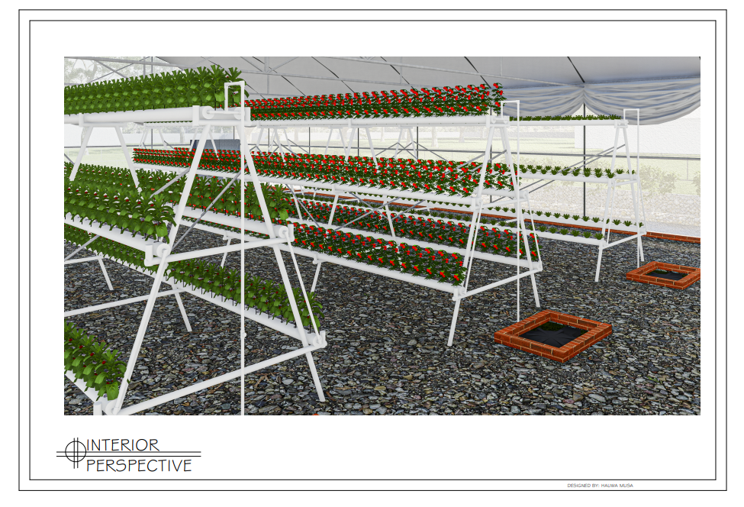

Slide 10
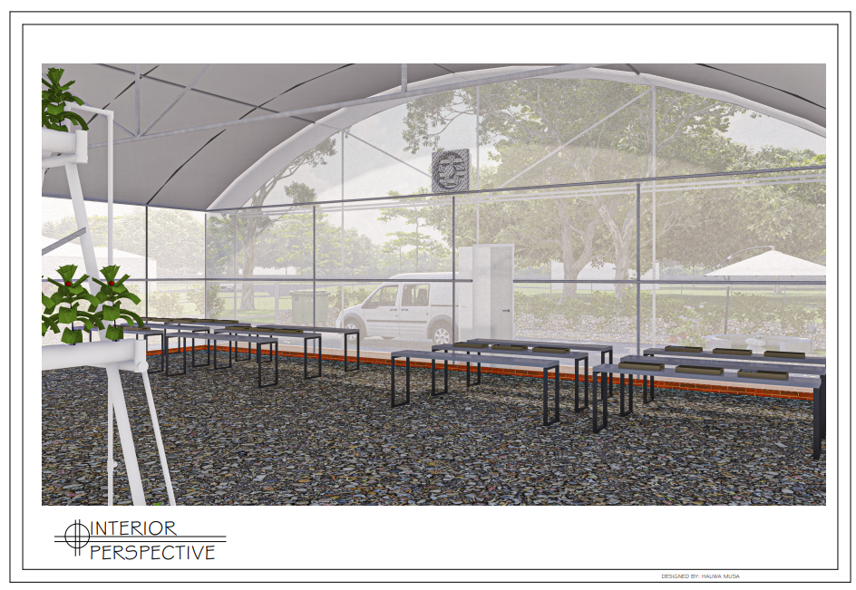

Slide 11
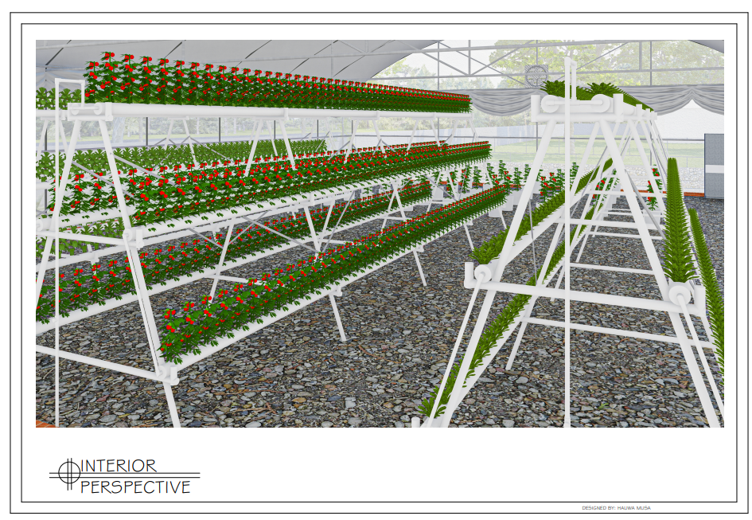

Slide 13
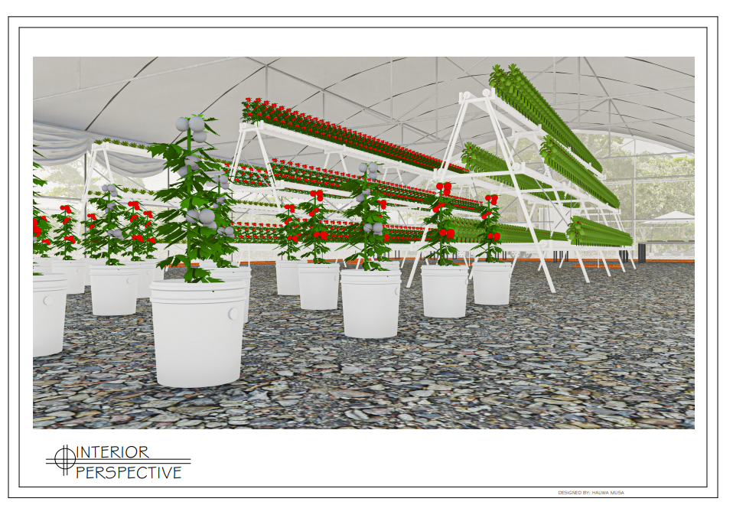

Slide 14
Proposed changes to the A&E design
DWC to be replaced by a trough system
Gate size to be reduced to pedestrian size.
Fence to be changed to Bamboo for more climate friendly material and adoption of locally available materials.
Three underground tanks for NFT system to be collapsed to one-tank.

Slide 15
Thank you for listening

