Slide 1






Research and Development Plan for New Climate Technology Cooperation Project in 2023
Strengthening Waste Management Policymaking in Uganda
in Response to Climate Change
[ Final Report ]
Dec. 2024

Slide 2
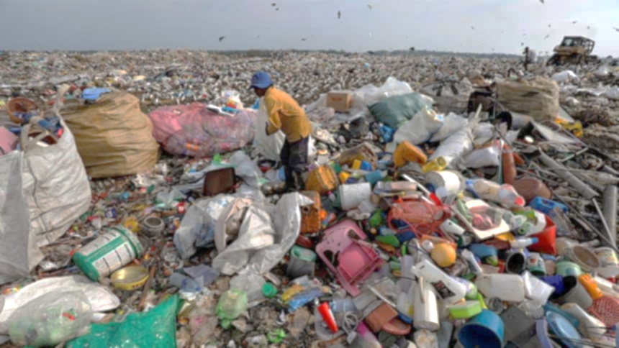
CONTENTS
01 Introduction
02 Results of the Study
03 Implementation Plan
04 Forthcoming Plan

Slide 3
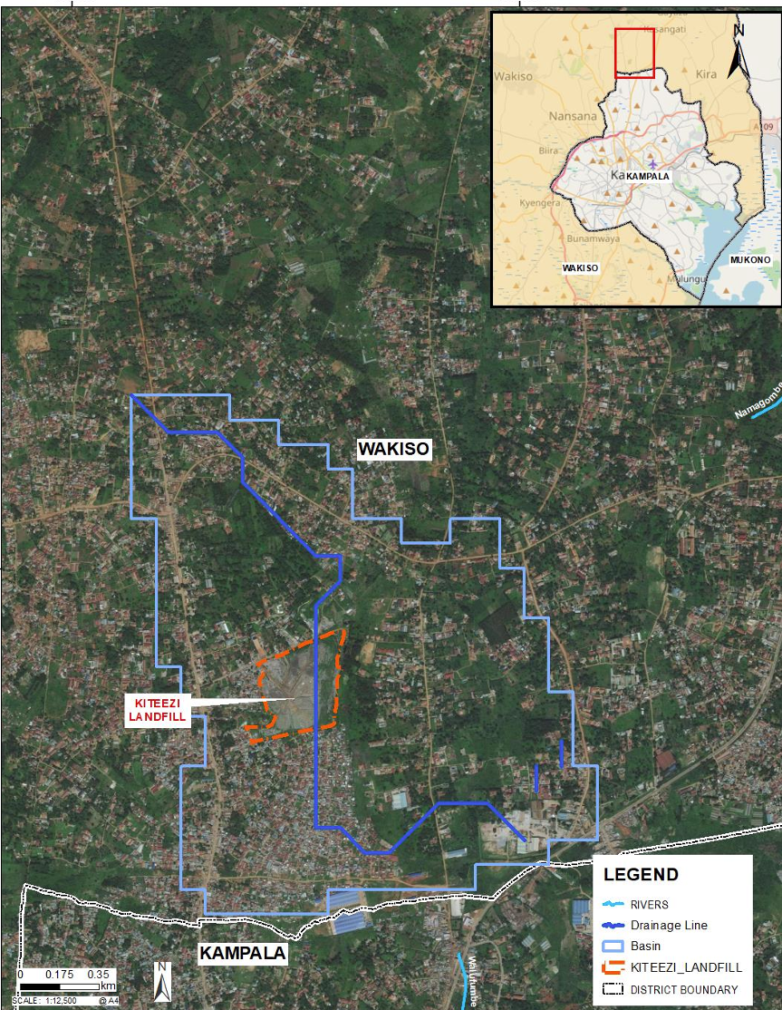
01
Introduction - Overview
Study Overview
Title | Strengthening Waste Management Policymaking in Uganda in Response to Climate Change
Approval / Funding | UNEP CTCN Technical Assistance Pro bono support from NRF (National Research Foundation) of Korea
Implementing Partner | THE HAMM SOLz Co., Ltd. with Water & Life Co., Ltd, and GES Co., Ltd.
Period | Nov. 2023 ~ Dec. 2024
Project Goals | Support the establishment of national policies related to waste landfills to properly dispose of waste Build the capacity of government officials to effectively implement climate change response projects Identify and develop pilot projects to reduce greenhouse gas emissions
Study Location
Location | Kiteezi landfill and Kampala City, Uganda
Waste Treatment Status | Of the about 3,200 tons of waste generated daily in the city, only about 1,200 tons was transported to the Kiteezi landfill before collapse on 10 August 2024. Kiteezi Landfill was until now Uganda’s largest in Uganda. There are no facilities for recycling waste, so it is simply dumped in an open dump. This leads to the release of harmful and greenhouse gases into the atmosphere. The national urban solid waste policy was established in 2017 The government is actively seeking alternative sites for waste disposal, with potential locations identified in Menvu, Nansana, and Busumamura in Kira Municipality.

Slide 4




01
Introduction - Organization
Funding
Technical assistance
Investment
Relevent
organizations
of this study
Ministry of Science,
Technology and Innovation
`
Ministry of Energy
and Mineral Development
NDE
PPA
KCCA Public Health Department
RP Agreement
LOI for GHG Reduction
DNA
EIA
Ministry of Water
and Environment
National Environment Management
Authority
※ KCCA : Kampala Capital City Authority
NDE : National Designated Entity
DNA : Designated National Authorities
PPA : Power Purchase Agreement
RP : Response Plan
GHG : Green House Gas

Slide 5

01
Introduction – Expected outcome
Implementation Plan
Stage 1
Basic Survey
Basic data research and analysis
On-site survey incl. landfill gas composition
Outcome
Field investigation report
Stage 2
Policy Proposal
Integrated management policy
Recycling plan
Greenhouse gas reduction
Outcome
Policy report for improving waste management
Recycling plan report for integrated waste management
Greenhouse gas reduction report
Stage 3
Capacity Building & Developing Project
Capacity building workshop
Developing project and securing fund
Outcome
Results of capacity building workshop
Project proposal

Slide 6
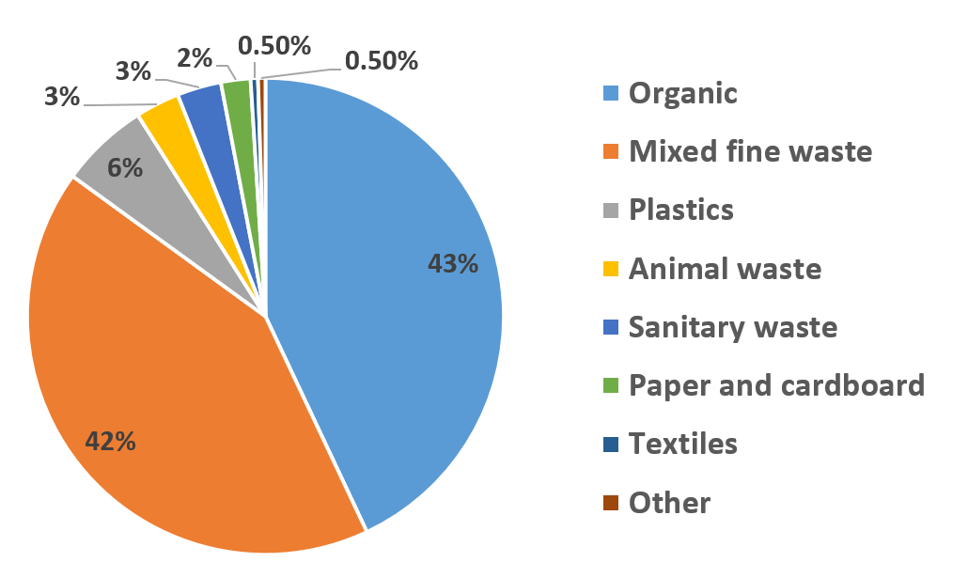
02
Results the Study – (1) Field investigation
Waste Characteristics in Kampala
▣ Waste composition
Composition | Ratio (%) | Remarks
Organic | 43.0 | Compostable
Mixed fine waste | 42.0
Plastics | 6.0 | Recyclable
Animal waste | 3.0
Sanitary waste | 3.0
Paper and cardboard | 2.0 | Recyclable
Textiles | 0.5
Others | 0.5
▣ Waste treatment status & characteristics
 | Organic waste ratio is high at about 43%. Waste generated is mainly landfilled (approximately 60%), and composting and recycling rates are low. At the final treatment stage, every valuables are taken by waste pickers from private sector An appropriate treatment plan is needed considering the composition of waste. ► Compostable: composting facility ► Recyclable: MRF (Material Recovery Facility)
Note) Data collection survey on municipal solid waste management in african cities, 2022, JICA

Slide 7
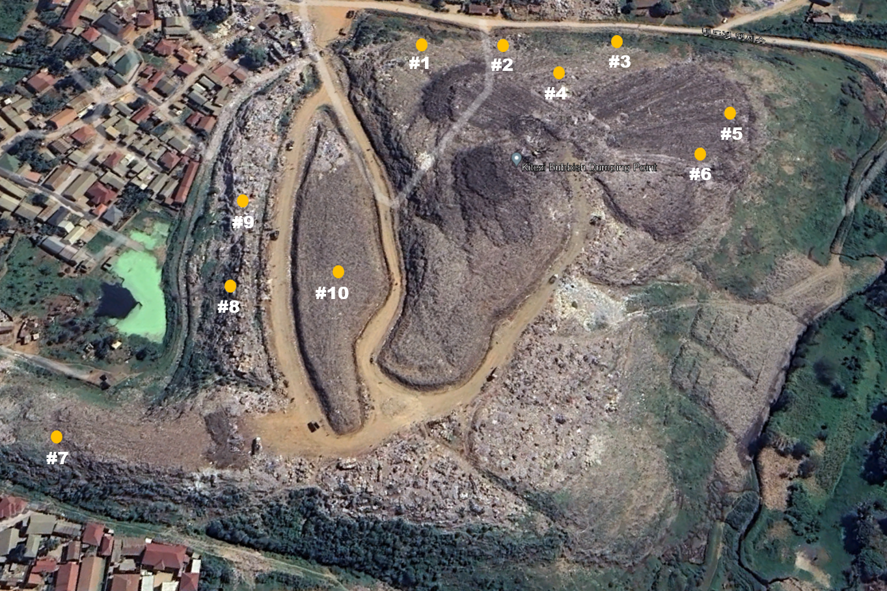
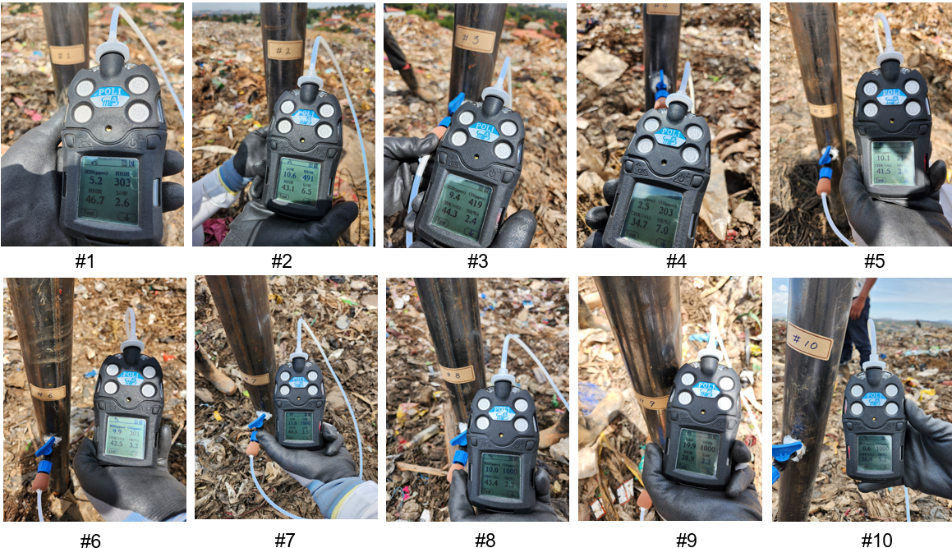
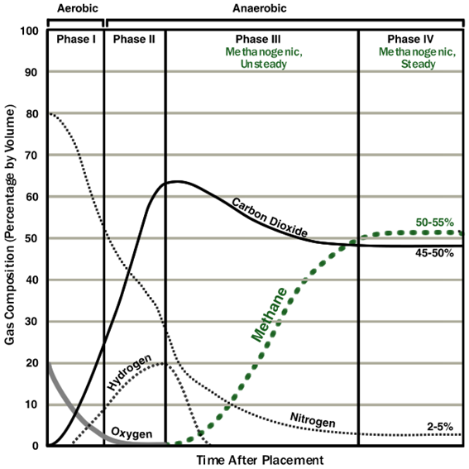
02
Results the Study – (1) Field investigation
LFG Composition of Kiteezi Landfill
▣ Field investigation
▣ Sampling location (10 points)
Date: 11, 12 March 2024
Number of sampling: 10 points 2 times
▣ Sampling method & measurement w/o pumping
▣ Results:
구분 | CH4 (%) |  | CO (ppm) |  | H2S (ppm) |  | O2 (%)
 | _{1차} | _{2차} | _{1차} | _{2차} | _{1차} | _{2차} | _{1차} | _{2차}
1 | 34.4 | 46.7 | 86 | 303 | 2.9 | 5.2 | 5.0 | 2.6
2 | 41.5 | 43.1 | 230 | 491 | 6.7 | 10.6 | 5.9 | 6.5
3 | 41.2 | 44.3 | 178 | 417 | 8.1 | 9.3 | 2.9 | 2.5
4 | 44.9 | 34.7 | 87 | 203 | 16.8 | 2.5 | 1.6 | 7.0
5 | 41.8 | 41.5 | 99 | 216 | 14.9 | 10.1 | 3.1 | 2.8
6 | 40.6 | 42.5 | 84 | 301 | 9.1 | 9.9 | 3.2 | 3.2
7 | 40.6 | 40.5 | 436 | 1,000 | 7.8 | 11.6 | 3.5 | 2.5
8 | 42.4 | 43.4 | 281 | 1,000 | 8.9 | 10.0 | 2.4 | 2.2
9 | 30.1 | 38.9 | 1,000 | 1,000 | 15.4 | 19.9 | 3.0 | 2.2
10 | 37.4 | 36.4 | 1,000 | 1,000 | 2.8 | 0.6 | 3.1 | 5.2

Slide 8

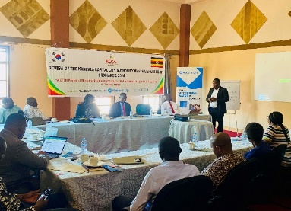
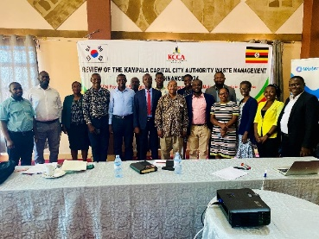
02
Results the Study – (2) Policy making support
Solid Waste Management Ordinance
▣ Technical Meeting
Date : 22 May 2024 ~ 8 October 2024 (total 4 times)
Venue : Silver Springs Hotel
Attendees: Technical representatives from KCCA and NEMA
Purpose : Review of Kampala Capital City Authority(KCCA)’s
Solid Waste Management Ordinacne (SI 243-21, 2011)
and assist in drafting a New Ordinance (2024) to replace it.
▣ Results
Items | SWM Ordinance, 2011 | SWM Ordinance, 2024
Scope and Definition | Focuses primarily on solid waste (including municipal and industrial waste), with no details on specific waste such as electronic waste. | Definitions expanded to include household, industrial, and e-waste, with clearer distinctions between waste types (e.g. household, industrial, e-waste) and recycling facilities such as Material Recovery Facilities (MRFs).
 | General mention of recycling but limited specific requirements for waste separation. | Regulations added mandating the separation of plastic waste from other waste at source, separating non-biodegradable waste (dry waste) from biodegradable waste (wet waste), setting e-waste collection centers and recycling targets.
Licensing and Regulation of Service Providers | Details regarding licensing of waste collection companies are limited. | Sets forth detailed permitting procedures, including application, vehicle standards, and facility inspection requirements, as well as penalties for unlicensed operation and renewal and suspension procedures.
Electronic and Hazardous Waste | Covers primarily municipal waste, with limited regulation of hazardous waste. | Added management guidelines for electronic waste, hazardous waste, and recyclables & recovery operations.
Fines and Fees | Limited on fines and fees | Specifies additional fees for application, inspection, and permitting to reflect an adjusted fee structure for new waste types and services.
Data Management and Reporting | No explicit requirements for data reporting. | Data management obligations added to require service providers to submit waste management data to authorities every six months.
Etc. | - | Repeals the 2011 Ordinance (SI 243–21) and establishes the 2024 Ordinance as the current regulatory framework.

Slide 9
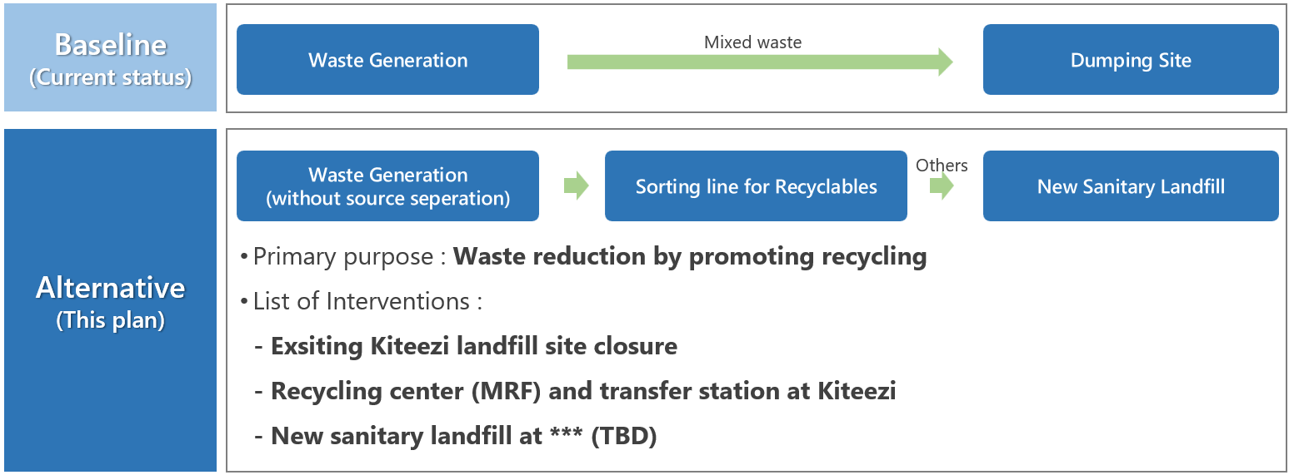
02
Results the Study – (3) MRF for integrated waste management
Proposal for Circular Economy through Integrated Waste Management (1/4)
▣ Purpose
To support resource circulation economy
To support integrated waste management system
To secure landfill capacity
▣ Proposal outline
MRF for recyclable waste & transfer station at Kiteezi site
New sanitary landfill for residues at *** site (TBD)
▣ Waste management scenario

Slide 10
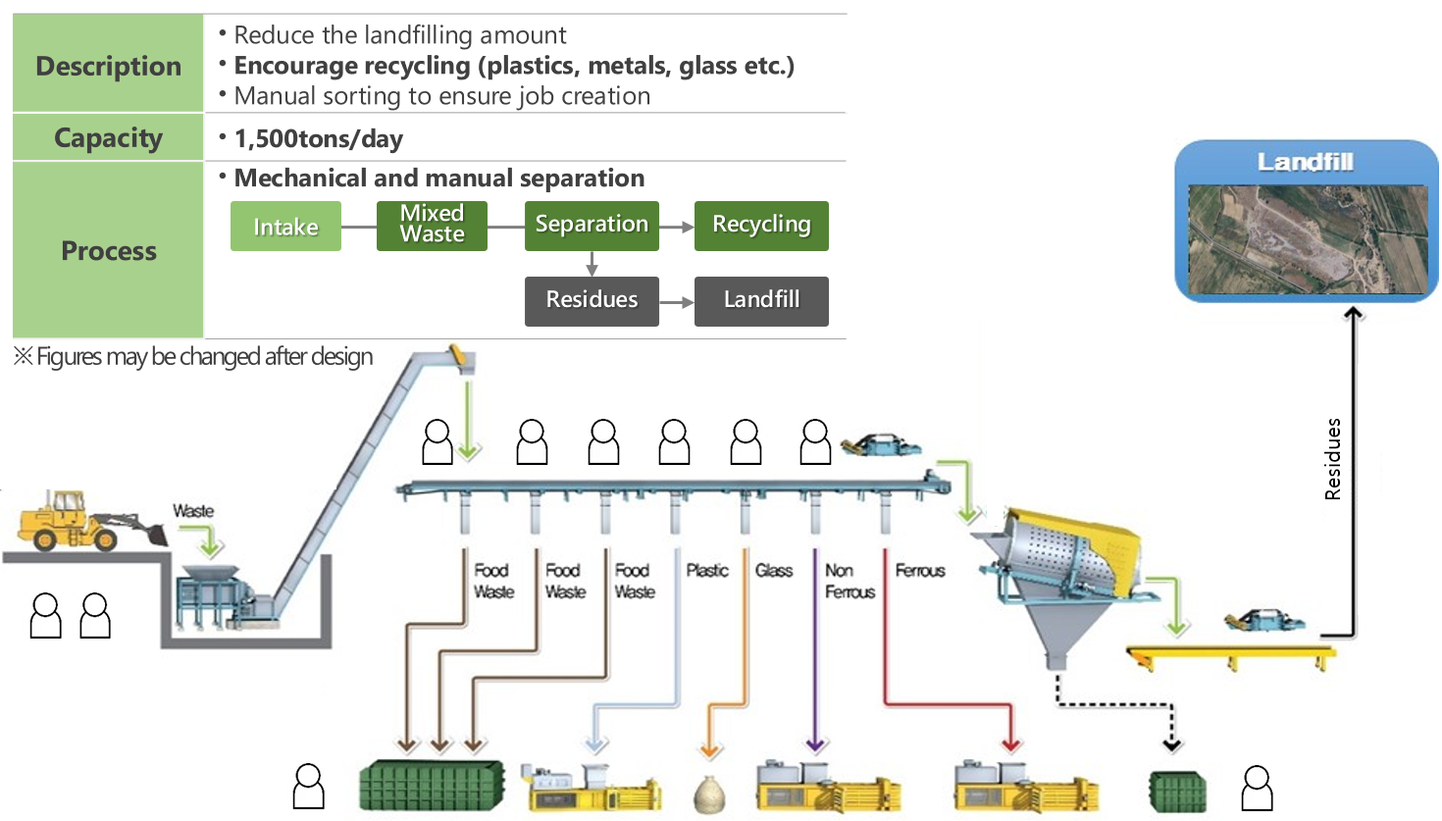
02
Results the Study – (3) MRF for integrated waste management
Proposal for Circular Economy through Integrated Waste Management (2/4)
▣ Concept of MRF

Slide 11
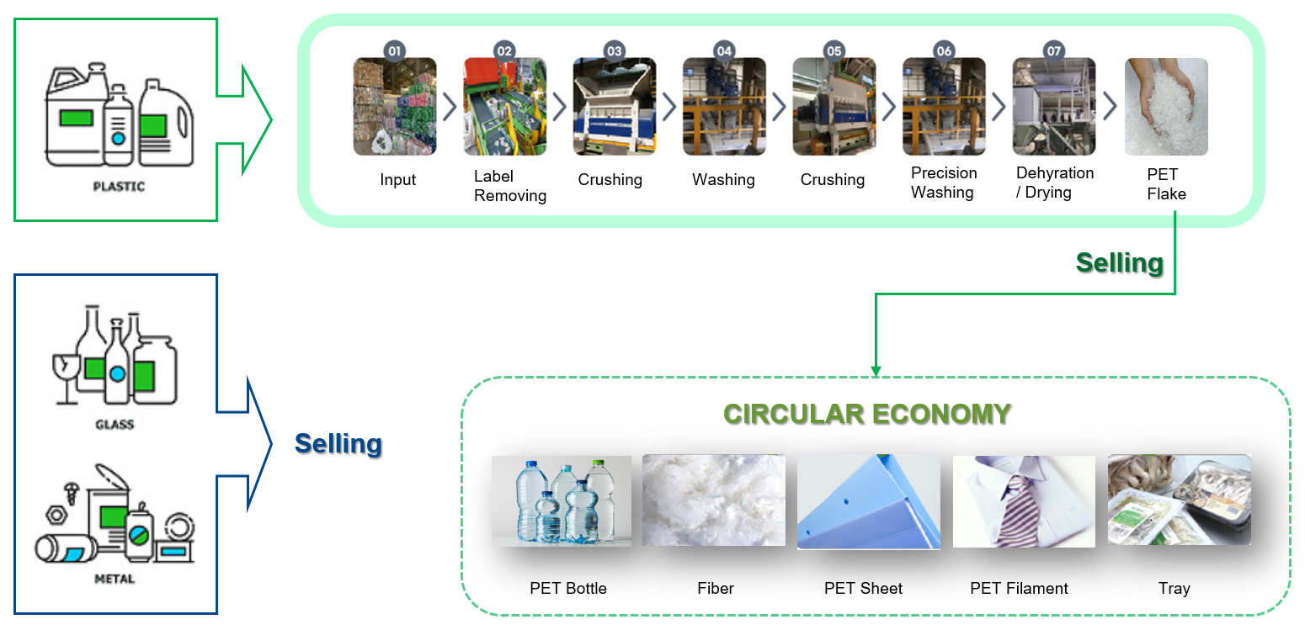
02
Results the Study – (3) MRF for integrated waste management
Proposal for Circular Economy through Integrated Waste Management (3/4)
▣ Concept of plastic recycling facility after MRF

Slide 12
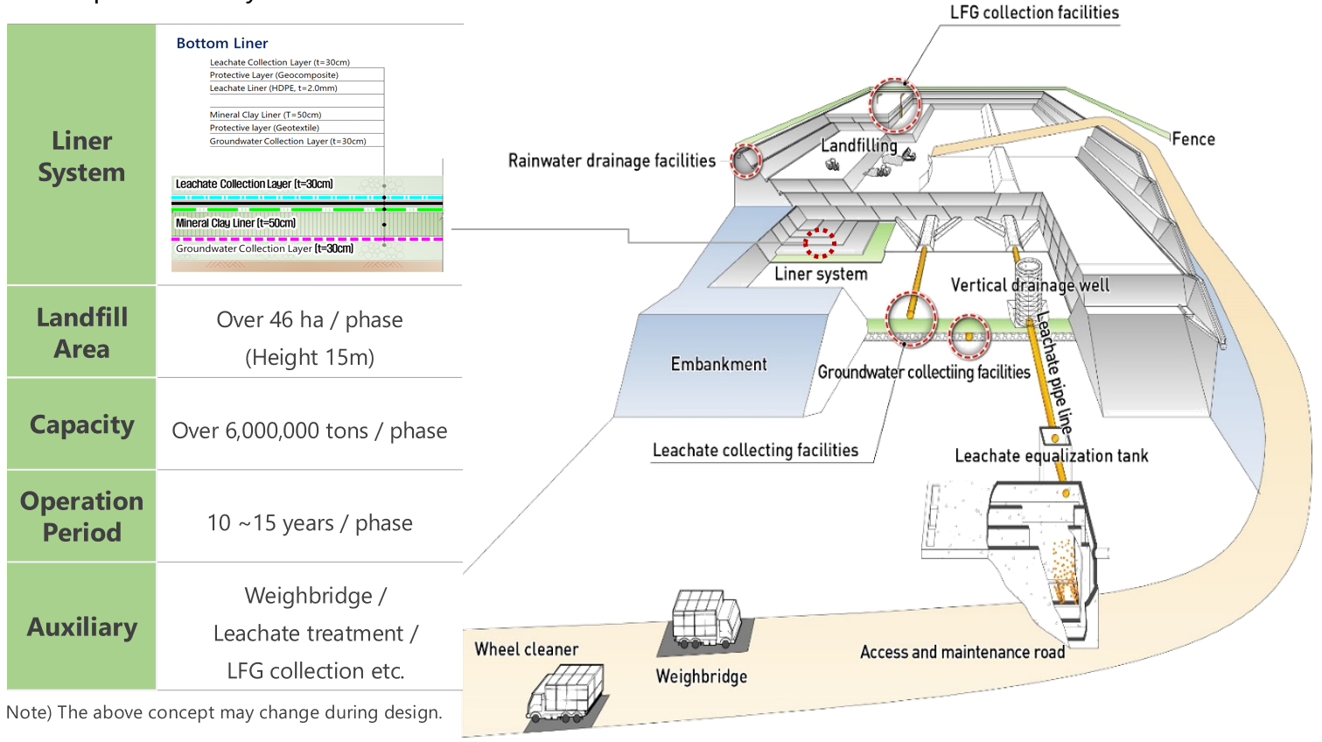
02
Results the Study – (3) MRF for integrated waste management
Proposal for Circular Economy through Integrated Waste Management (4/4)
▣ Concept of sanitary landfill

Slide 13
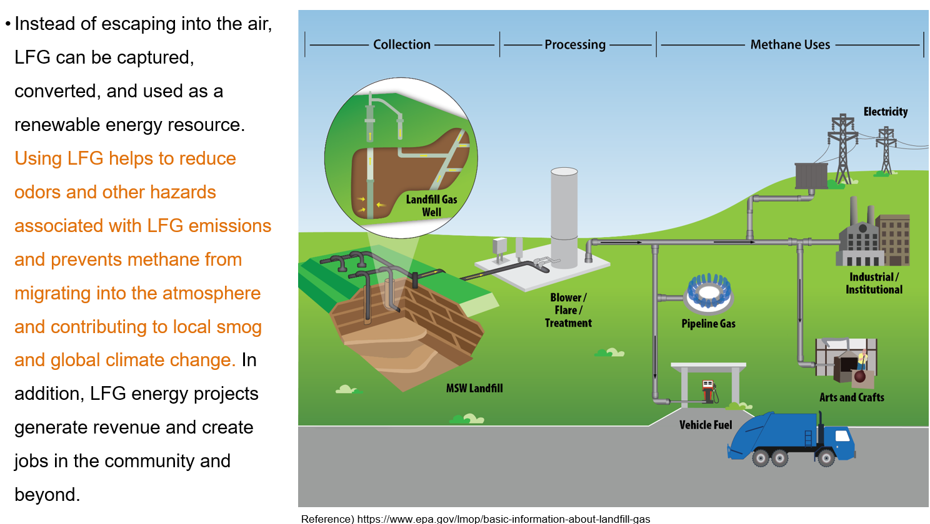
02
Results the Study – (4) Green House Gas (GHG) reduction
Proposal for GHG Reduction Project at Kiteezi Site (1/4)
▣ Concept of collection and treating landfill gas

Slide 14
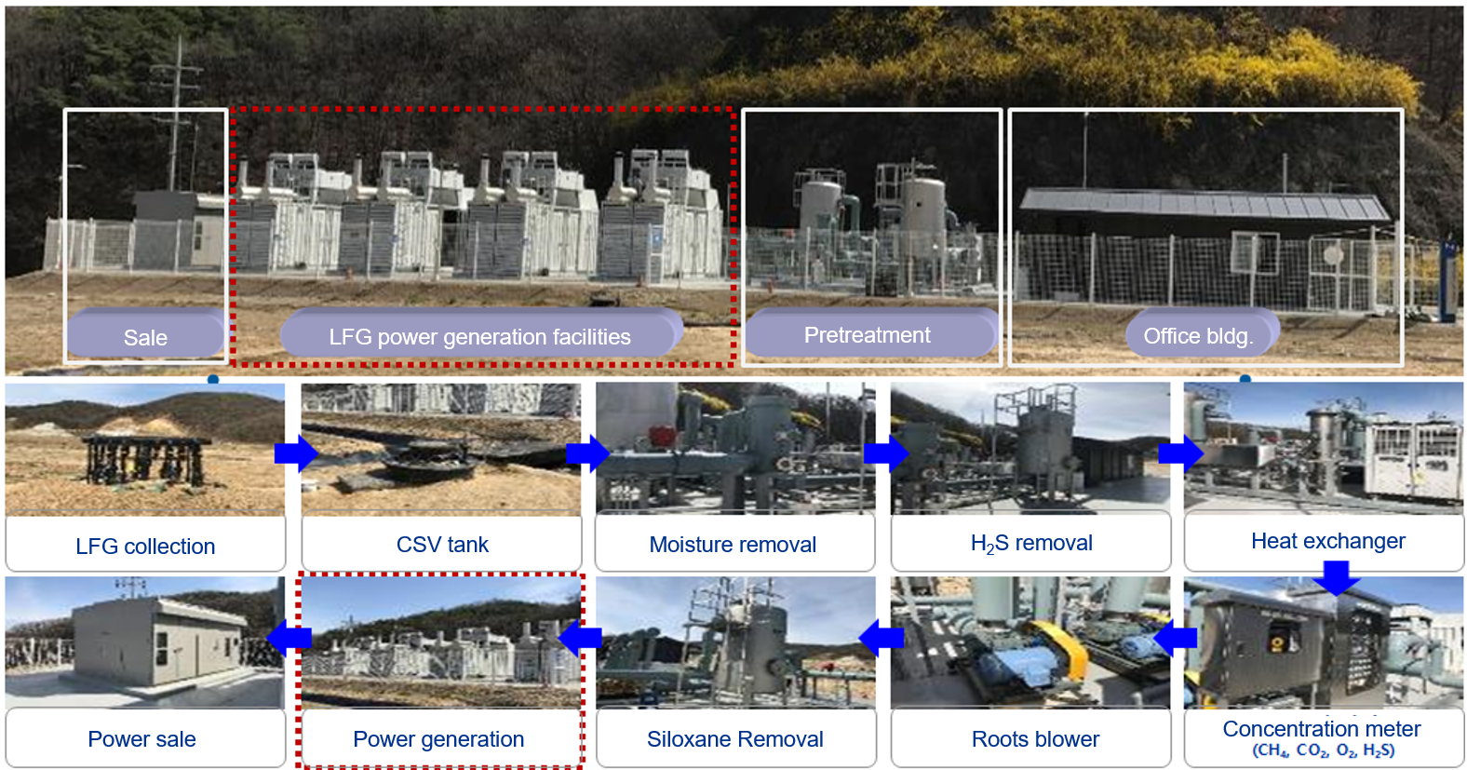
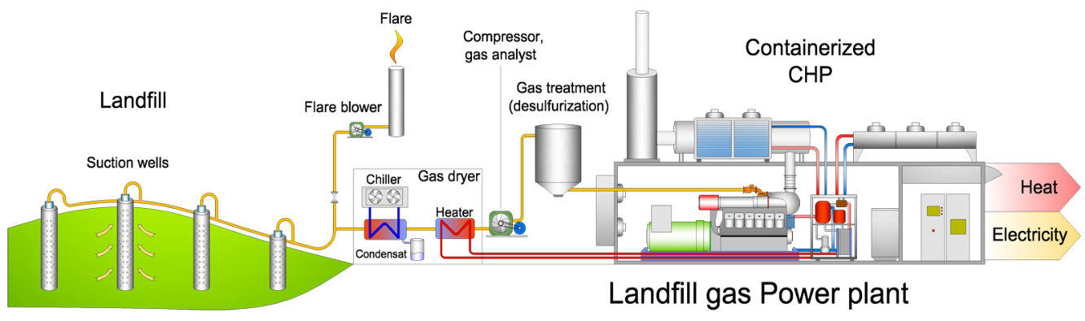
02
Results the Study – (4) Green House Gas (GHG) reduction
Proposal for GHG Reduction Project at Kiteezi Site (2/4)
▣ Technologies for LFG processing & power generation
Dumpsite closure
Securing greenhouse gas emissions rights by capturing and refining landfill gas and using it as power generation fuel
Facilities are divided into processes that collect landfill gas and cogeneration facilities that utilize purified landfill gas.
Landfill gas is stored in a CSV (Condensate Separate Vessel) tank through a collection facility, and moisture and hydrogen sulfide are removed through a purification facility.
Refined gas is fed into a combined heat and power (CHP) plant as fuel, and the final byproducts are waste heat and electricity.

Slide 15

02
Results the Study – (4) Green House Gas (GHG) reduction
Proposal for GHG Reduction Project at Kiteezi Site (3/4)
Methodology
Step 1
Category | Business scale |  | Methodology name | Note
AMS-Ⅲ.G. | Small | Reduction up to 60,000 tons | Landfill methane recovery, Version 10.0 | Assessing the validity of expected GHG reductions in renewable energy projects of similar scale in developing countries. Proposal of project promotion type PA (single project) or PoA (program project) considering the potential demand of landfill sites, reduction effect size, and project operation period
ACM 0001 | Big | Reduction exceed to 60,000 tons | Flaring or use of landfill gas, Version 19.0
AMS-Ⅰ.D. | Small | Power generation up to 15MW | Grid connected renewable electricity generation, Version 18.0
Calculation of greenhous gas reduction
Expected effect
Step 2
Step 3
$$ER_{y,estimated} = (BEy,CH4+BE_{y,Power})− (PE_{y,flare} +PE_{y,Power}) −LE_{y}$$
Year | Baseline emissions (t CO₂e) | Project emissions (t CO₂e) | Leakage (t CO₂e) | Emission reductions (t CO₂e)
Year 1 | 130,317 | 274 | 0 | 130,043
Year 2 | 125,834 | 274 | 0 | 125,560
Year 3 | 121,506 | 274 | 0 | 121,232
Year 4 | 117,327 | 274 | 0 | 117,053
Year 5 | 113,292 | 274 | 0 | 113,018
Year 6 | 109,395 | 274 | 0 | 109,121
Year 7 | 105,633 | 274 | 0 | 105,359
Year 8 | 101,999 | 274 | 0 | 101,725
Year 9 | 98,491 | 274 | 0 | 98,217
Year 10 | 95,104 | 274 | 0 | 94,830
Total | 1,118,899 | 2,740 | 0 | 1,116,159
Total number of crediting years |  | 10 years
Annual average over the crediting period | 111,890 | 274 | 0 | 111,615
- Estimated GHG reduction amount:
Annual average 111,615 tCO_{2eq}
- Estimated power generation:
1.5MW (13,140 MWh/year)
- Effectiveness
⇒ Contributing to offset BAU (148.8 MtCO₂eq)
and to achive NDC target in 2030, Uganda
⇒ Contributing to stable electricity supply

Slide 16
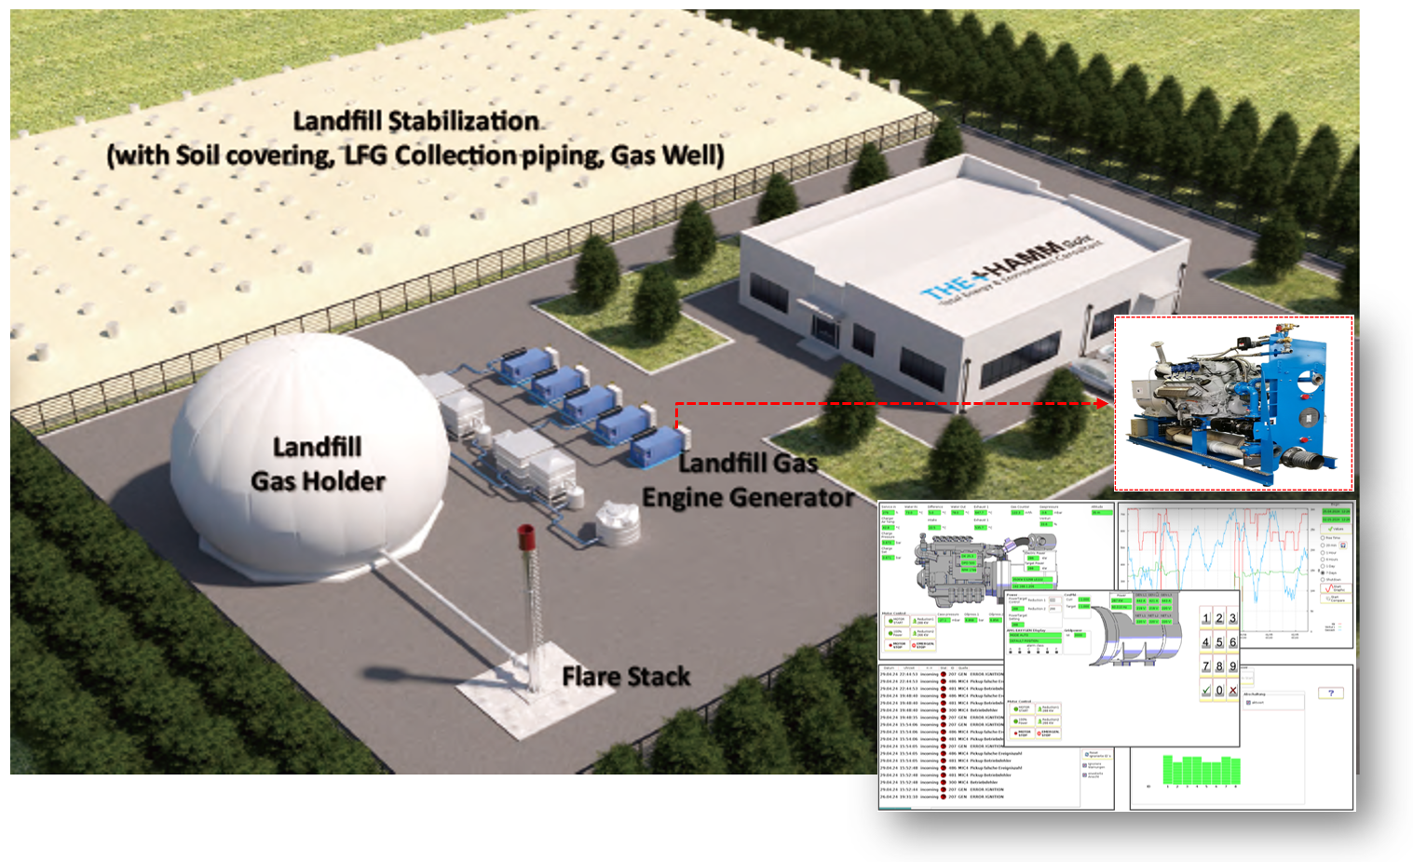
02
Results the Study – (4) Green House Gas (GHG) reduction
Proposal for GHG Reduction Project at Kiteezi Site (4/4)
▣ Layout Plan (example) and O&M

Slide 17
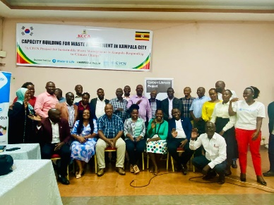
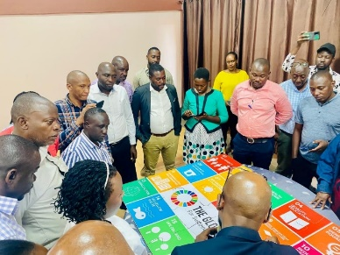
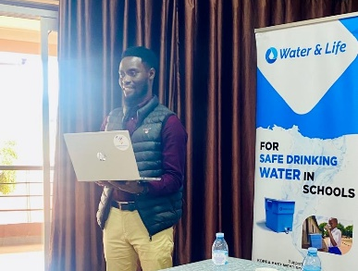
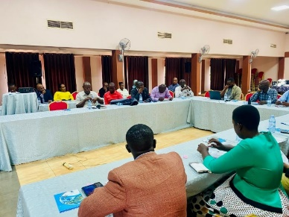
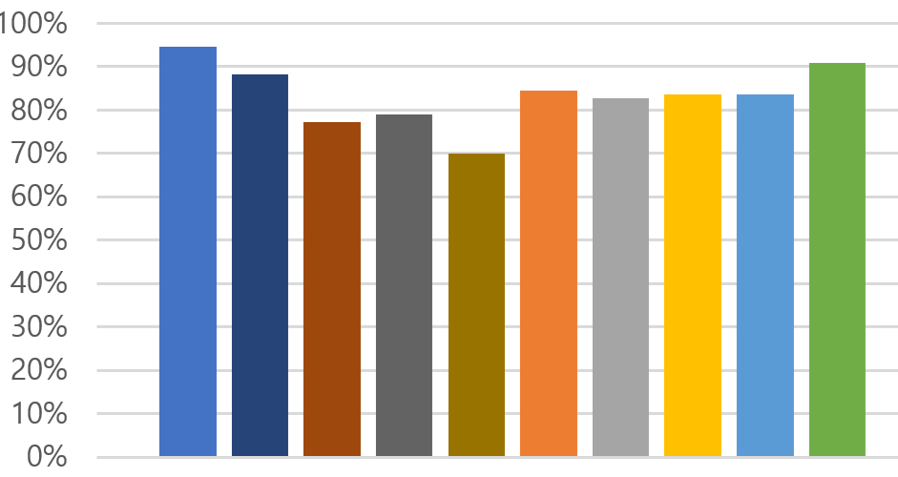
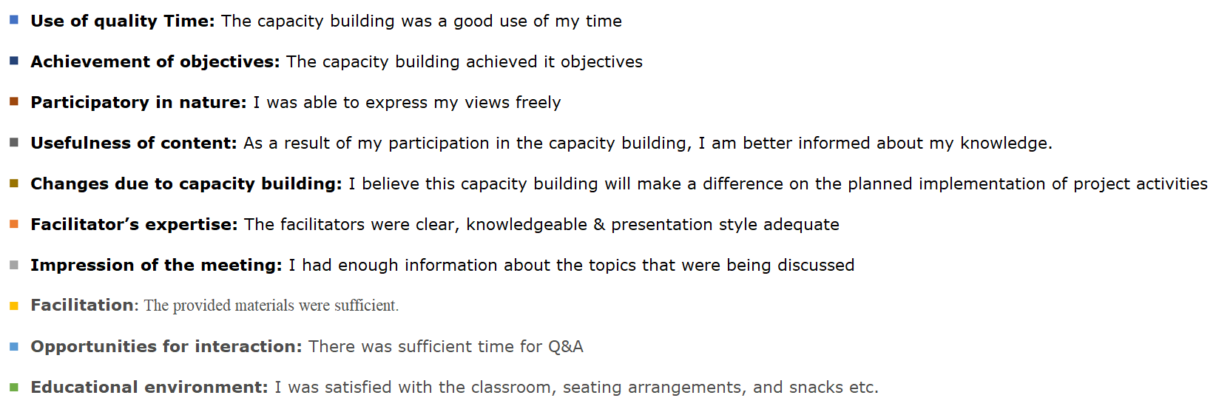
02
Results the Study – (5) Capacity building
Workshop
Date : 19 ~ 20 September 2024 (total 2 times)
Venue : Silver Springs Hotel
Attendees: KCCA Public Health Department
and private waste collection companies, etc.
Purpose : Training on waste recycling technologies,
providing information and capacity building to stakeholders,
and encourage the creation of social and economic opportunities
Program
- Waste management policy and related legal requirements promoted by KCCA
- Introduction of innovative recycling technologies introduces various technologies that convert waste into resources
- Explore the possibility of creating new businesses through recycling
Evaluation Survey

Slide 18
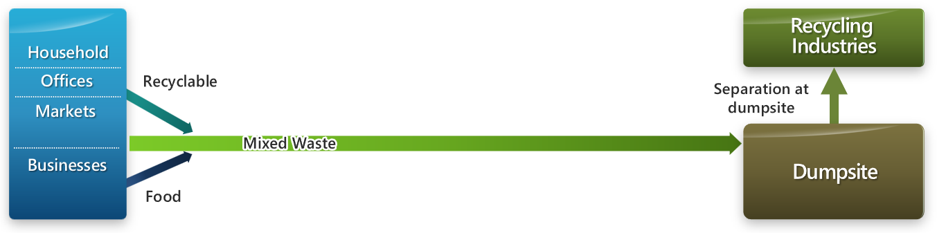
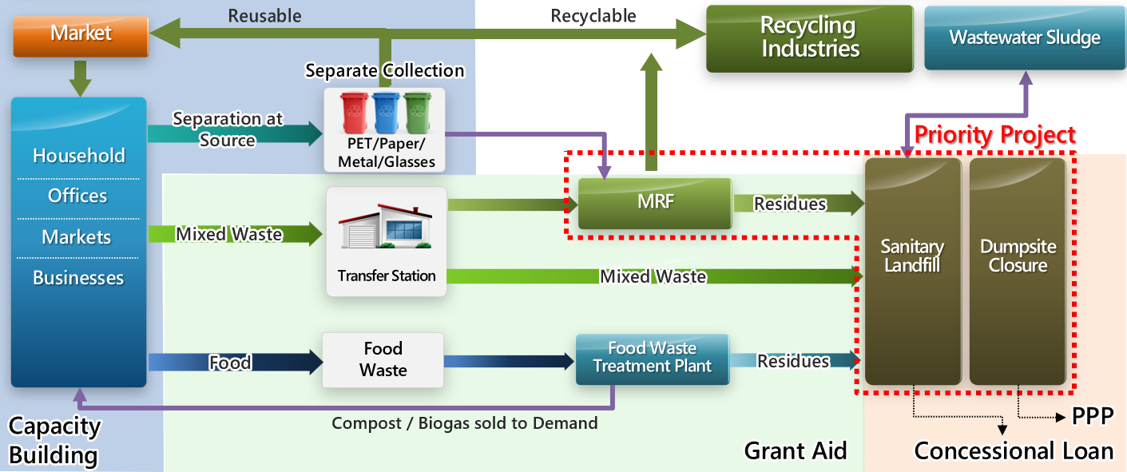
03
Implementation Plan
Present
Future (suggestion)
▣ 현지 NGO 단체
16

Slide 19
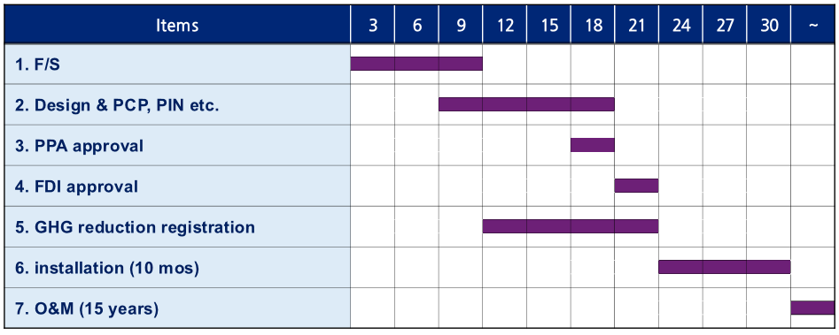
04
Forthcoming Plan
Issue 01
Cooperation Consensus (LOI w/Ministry of Water and Environment)
Conclude a cooperation consensus in waste management (Not binding) to develop GHG project
Issue 02
Future Schedule for GHG project
17

Slide 20


Thank you

