Slide 1

Assessment of Applicable Climate Technologies for Establishing Baseline GHG Emissions from Cattle Farming in Cuba
CTCN Reference Number: 2018000010

Slide 2
Objectives
Assist Cuba in the development of an initial estimate of a baseline of its livestock emissions;
Estimate the greenhouse gas reduction potential of implementing best practices;
Identify the potential adaptation co-benefits of adopting climate-smart livestock management practices;
Disseminate to local stakeholders (e.g. researchers, specialists, local leaders) on the learnings of the project;
Develop related communication documents to further implementation of climate-smart management;
Develop an outline of a concept note for support from the Green Climate Fund to implement a project to achieve improved climate-smart production for Cuba with lower greenhouse gas emissions.

Slide 3
Project Timeline
Covid caused major changes to the project because travel to and within Cuba was severely restricted
Start
06/2019
Cuban Team consults and develops
Initial Set of Climate-Smart Improvements (scenarios)
05-09/2020
Emission Estimates and Report on Climate-Smart Improvements Shared
02-03/2021
Development and Refinement of Baseline data from Cuban Team 10/2019 – 03/2020
Development of handbooks on Climate-Smart Improvements
03-04/2021
Baseline Emissions Estimates
03/2019
Emission Estimates and Summary on Climate-Smart Improvements Shared by Cuban Team with Cuban Stakeholders for Feedback and Revision 11/2020
Draft outline of Concept Note to Green Climate Fund
04/2021
Baseline Estimates and Database Shared with Cuban Team for Education and Feedback
03-04/2020
Concluding Presentation
06/2021
Climate-Smart Scenarios Revised
12/2020-01/2021
End
06/2021

Slide 4

Baseline Emissions for Cattle Production
CH₄
N₂O
CH₄
CO₂

Slide 5
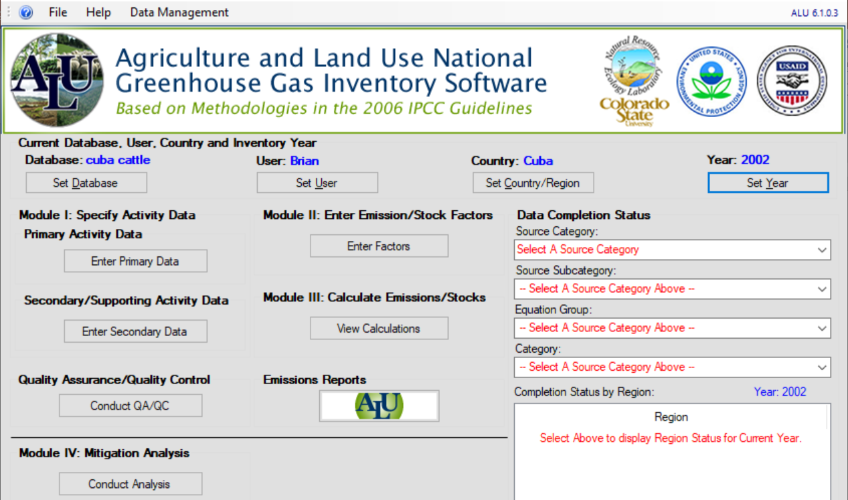
Agriculture and Land Use (ALU) software (free) used to produce inventories of
GHG emissions
More detailed (Tier 2) emission estimates
Free software
Produces Access databases

Slide 6
2018 Baseline emissions
Type | Head | Enteric CH₄ emissions (‘000 tonnes CH₄) | Enteric CH₄ emissions (‘000 tonnes CO2e) | Manure CH₄ (‘000 tonnes CH₄) | Manure CH₄ (‘000 tonnes CO2e)
Females < 2 year | 616600 | 20 | 512 | 0.14 | 3
Heifers | 749900 | 118 | 2945 | 0.78 | 19
Cows | 1169100 | 42 | 1043 | 0.27 | 7
Males < 2 year | 587400 | 50 | 1256 | 0.13 | 3
Males > 2 year | 685400 | 20 | 491 | 0.34 | 8
+ N₂O emissions from manure total = 1660 t of N₂O or 493100 t of CO2e

Slide 7
Baseline Results
Emission per animal were higher than expected
  Higher than what Cuba currently estimates in its national communications
    Cuba used Tier 1 methods where the emission per cow is set
    This study used Tier 2 methods that tries to meet animal nutritional needs
      Intake of poor quality grazed vegetation is higher to try to meet nutritional needs and this produces higher estimated enteric emissions of methane
Productivity is low compared to other countries in Latin America and the Caribbean
  Higher mortality rates and lower birth rate.
  Low milk yield and weight gain primarily due to poor livestock diet.
  Low incomes

Slide 8

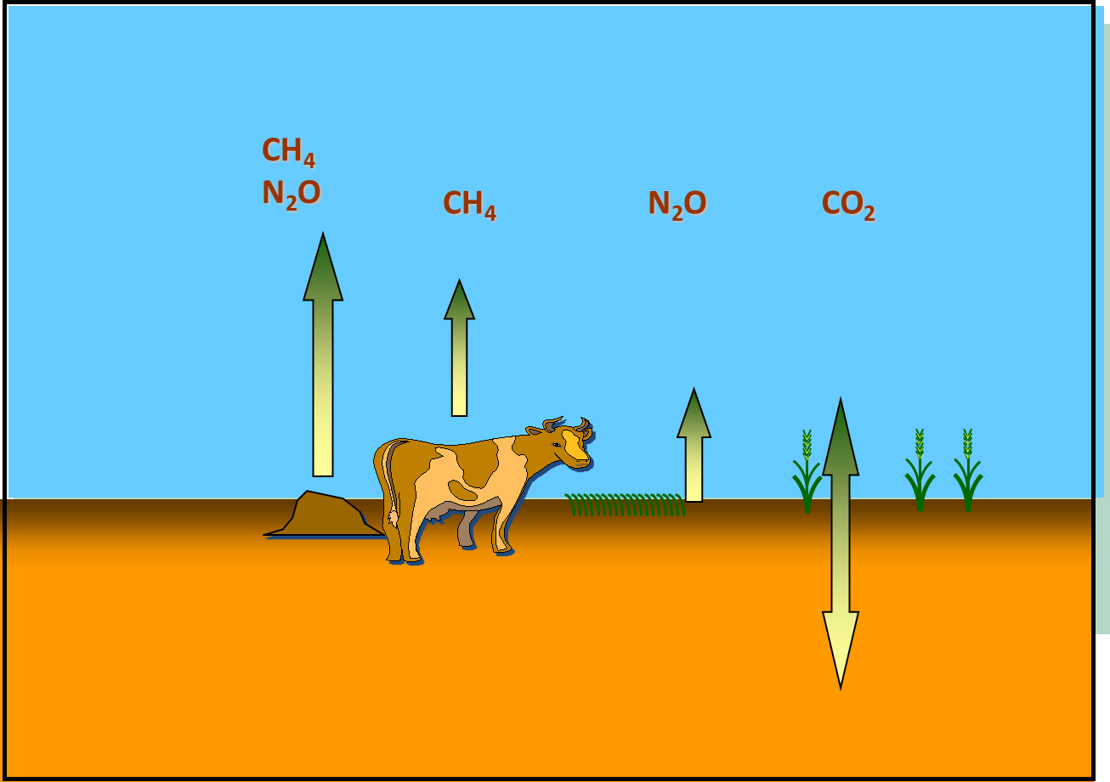
The Cuban Team developed practical scenarios of improved practices
All involve
  adding higher quality forage to supplement pasture when its quality is low
  Better management of pastures including control of undesired invasive species, rejuvenating with new seeding, and dividing large pastures into multiple paddocks for rotational grazing
  Improving herd health (higher birth rates and lower mortality)
Productivity will be increased
Herd size is reduced since females calf at younger ag and males reach slaughter age sooner
The effect of GHG emissions is complex: new N2O emissions from the land from fertilization, some new carbon sinks on land, and some livestock emissions increase and some decrease over the lifetime of male and female cattle

Slide 9
Climate-Smart Scenarios to Investigate the Effects of Emissions and Productivity
Each scenario had 1000 cows
The characteristics of cattle production such as birth rate, mortality, weight gain were set to reflect the impact of multiple changes to the production system
  Better pasture through appropriate management
  Stored forage to supplement diet when grazing low quality vegetation
  Herd health improvements from appropriate management
The number of other age groups of cattle for the 1000 cows were developed based on birth rates, mortality, and age to reach the desired mature weight
Three levels of increasing improvement: A, B, C

Slide 10
4 Scenarios
All scenarios have 1000 cows of 450 kg
Base scenario (represents current situation)
Natural pastures (ha): 1438
Mortality: 30% young animals, 20% old animals
Gain (kg / animal / day): 0.03-0.32
Milk production per milking cow (kg / day): 3.1
Proportion of pregnant animals (%): 50
Proportion of cows milked (%): 50
Annual milk production (kg): 511000
Annual production of carcass weight for meat (kg): 60500

Slide 11
Scenario A (modest improvements from base scenario)
Natural pastures (ha): 1338
Fertilized forage (ha): 100
Mortality: 20% young animals, 10% old animals
Gain (kg / animal / day): 0.1-0.32
Milk production per milking cow (kg / day): 6
Proportion of pregnant animals (%): 50
Proportion of cows milked (%): 60
Annual milk production (kg): 1277500
Production of carcass weight for meat(kg): 74000

Slide 12
Scenario B (large improvement from base scenario)
Natural pastures (ha): 331
Fertilized cultivated pastures (ha): 1007
Fertilized forage (ha): 100
Mortality: 15% young animals, 10% old animals
Gain (kg / animal / day): 0.5-0.55
Milk production per milking cow (includes nurse cow production), (kg / day): 8
Proportion of pregnant animals (%): 60
Proportion of cows milked (%): 65
Annual milk production (kg): 1679000
Annual production of carcass weight for meat (kg): 91000

Slide 13
Scenario C (total change from current production system based on natural pastures)
Natural pastures (ha): 0
Fertilized cultivated pastures (ha): 1050
Fertilized forage (ha): 100
Silvopastoral systems (ha): 288
Mortality: 10% young animals, 5% old animals
Gain (kg / animal / day): 0.1-0.7
Milk production per milking cow (includes suckler production), (kg / day): 9.5
Proportion of pregnant animals (%): 70
Proportion of cows milked (%): 70
Annual milk production (kg): 2095100
Annual production of carcass weight for meat (kg): 120000
Biogas digestion of collected manure for biogas fuel

Slide 14

Results
All calculated emissions were made using ALU software following the 2006 IPCC guidelines.

Slide 15
Emissions
 | Emissions ( t CO₂e)
 | Scenario
Source | Base | A | B | C
Methane emissions from enteric fermentation | 4515 | 2583 | 3195 | 3348
Methane emissions from manure | 30 | 12 | 16 | 16
Emission of N2O from managed soils | 128 | 141 | 709 | 738
Change in soil carbon stocks | 0 | -219 | -2427 | -2881
Change in biomass carbon stocks | 0 | 0 | 0 | -3911
Total | 4673 | 2517 | 1493 | -2690

Slide 16
Emission Intensity
 | Emission per unit of production
Scenario |  | Milk (kg CO₂e/kg milk) | Meat (kg CO₂e/kg carcass weight)
Without carbon change |  |  |  | 24.7
Base |  | 8.2 | 69.0
A |  | 2.3 | 39.6
B |  | 2.3 | 40.0 | 25.4
C |  | 2.1 | 36.4 | 21.4
With carbon change
Base |  | 8.2 | 69.0
A |  | 1.3 | 22.4
B |  | 0.2 | 3.0
C |  | -1.5 | -26.1

Slide 17
Comments
The standardized scenarios worked very well to analyze and compare the effects of the change to more climate-Smart cattle production systems (Bravo, Dra. Tania Sánchez Santana)
The base scenario has about twice the GHG intensity for milk and about the same GHG intensity for meat compared to other countries in Latin America and the Caribbean (LAC)
The improved production practices in the scenarios decreased GHG intensity of milk and meat to about 55 to 60 % of typical value for the LAC region
Any greenhouse gas emission from the approximate 40 t of biogas (energy equivalent of 60000 L of diesel fuel) in scenario C were not included because depends if it displaces emissions from fossil fuels.
Changes in carbon stocks had a large impact on reducing the GHG intensity
  The intensity became negative (net reduction in GHG emissions) for the first 20 years after changes for scenario C that includes 20% of land areas in a silvopastoral

Slide 18
Opportunities Depend on the Amount of Implemented Practices
Because of the large increases in milk and meat production per cow with improved climate-smart production practices, the current production can be met with a smaller total cattle herd and less land area for cattle production
  The land not used for cattle could be planted to forest to help meet Cuba’s ambition to increase total forest areas by 33% under its climate change plan under the Paris Agreement
% of Cuban cows in scenario |  |  |  | Head | % of value for current situation of 100% of cows in the base scenario
Base | A | B | C | Cows | Production Area | Milk production | Meat production | GHG without C | GHG with C
100 | 0 | 0 | 0 | 1169100 | 100 | 100 | 100 | 100 | 100
85 | 5 | 5 | 5 | 1169100 | 95 | 133 | 108 | 98 | 84
85 | 5 | 5 | 5 | 1079003 | 87 | 123 | 100 | 90 | 77
75 | 10 | 5 | 10 | 1169100 | 91 | 156 | 114 | 97 | 73
75 | 10 | 5 | 10 | 1023282 | 80 | 137 | 100 | 85 | 63
33 | 17 | 16 | 33 | 818370 | 52 | 182 | 100 | 65 | 13
10 | 30 | 10 | 50 | 888516 | 50 | 244 | 121 | 70 | -9

Slide 19
Potential projects
Substantial increases in milk and meat production are possible with modest reductions in GHG emissions.
Substantial reductions in GHG emissions are possible with modest increases in milk and meat production.
Cuba needs to decide on the target types and amounts of improvements to cattle production systems to meet the desired food production and GHG emissions given the feasibility of making those improvements.
Silvopastoral are particularly attractive for GHG reductions because of added reduction from increased carbon sequestration.

Slide 20
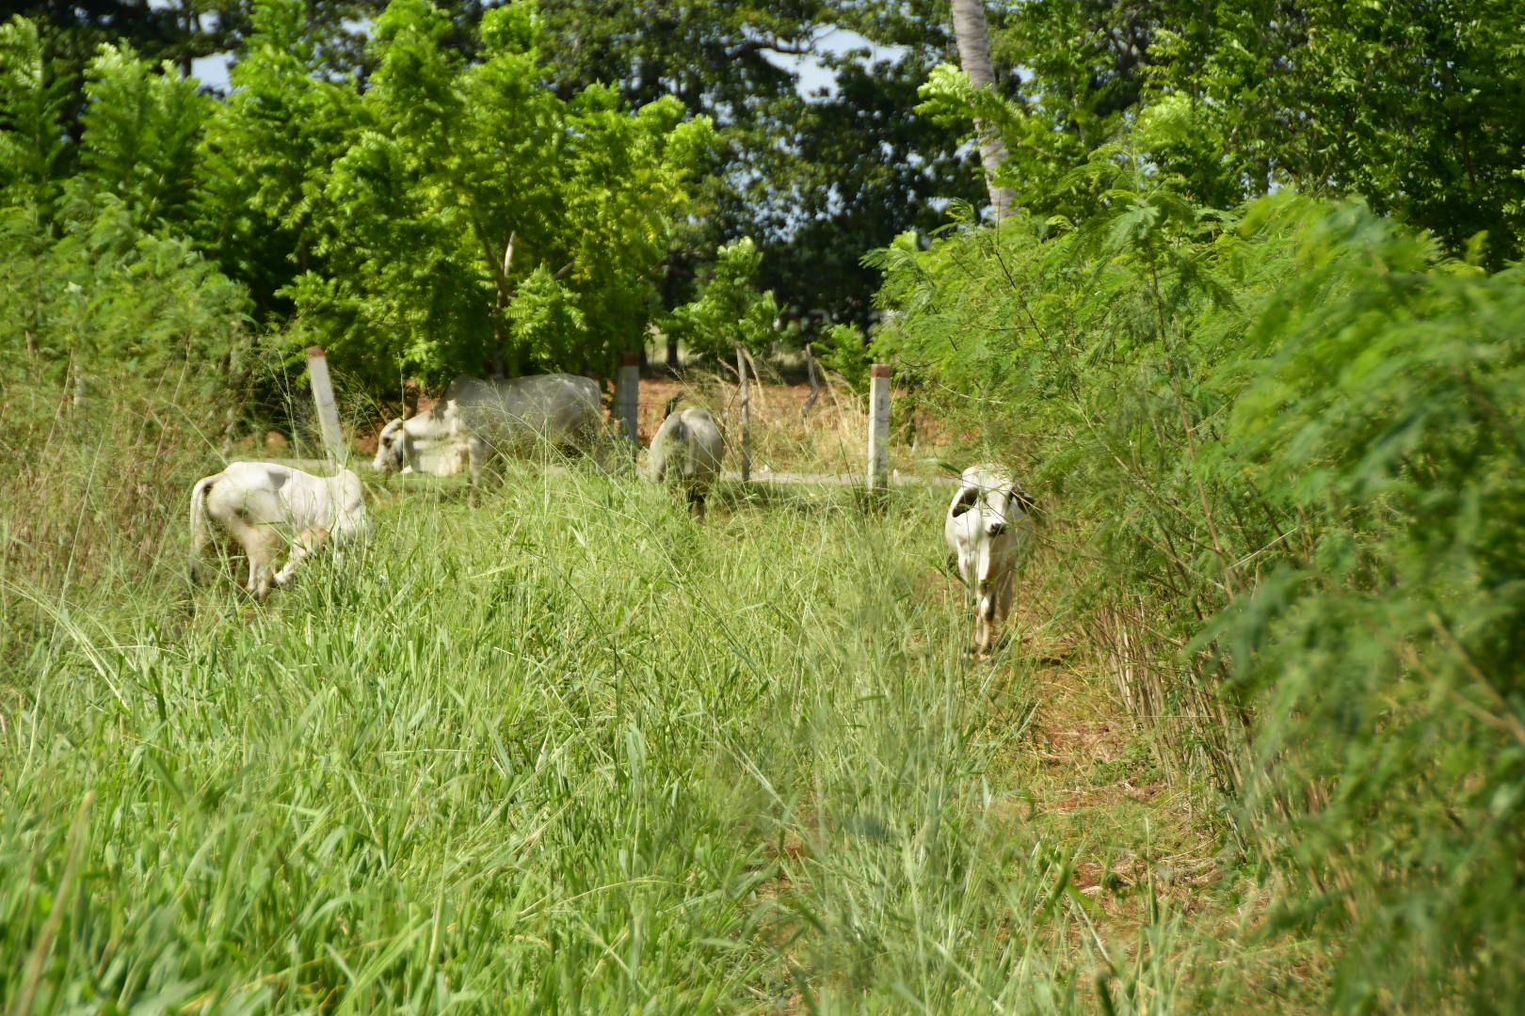
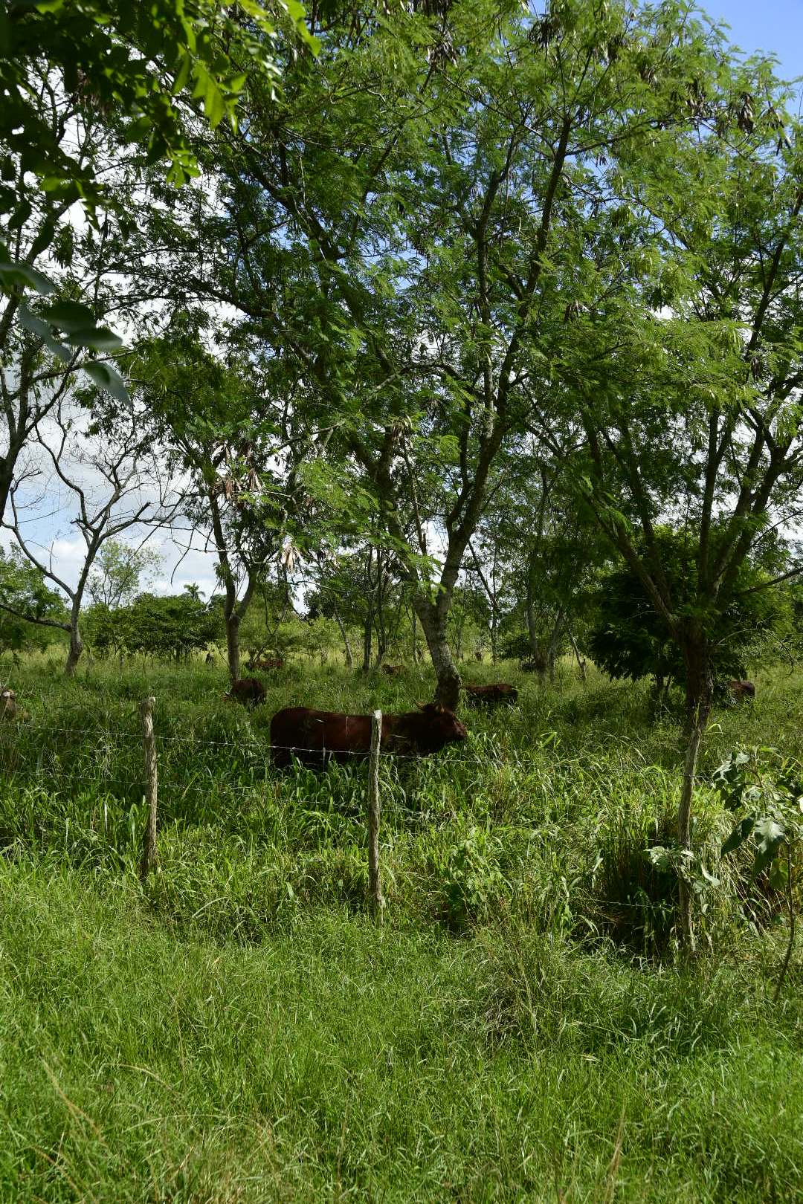
Green Climate Fund
$ €
Implementation
s
Climate-Smart Improvements
More efficient production =
More meat +
More milk +
Lower GHG emissions +
More land for forests

Slide 21
Summary
There are many challenges to cattle production in Cuba that cause milk and meat production with low productivity and high greenhouse gas (GHG) emission intensity
The Cuban team has identified several suites of climate-smart practices that improve diet, health, and productivity of cattle
  A modest changes of improving pasture management and adding supplemental feeding with stored forage with improved herd health can reduce total emissions by 27% while increasing milk production by 250% and meat production by 21%
  A large change with greater pasture improvements and adding supplemental feeding with stored forage with improved herd health can reduce total emissions by 1-0% while increasing milk production by 300% and meat production by 52%
  A complete change with conversion of all natural pastures to tame pastures plus stored forages plus 20% of area in silvopastoral systems can increase milk production 4 times and double meat production
Greenhouse gases emission are reduced further if soil and biomass carbon stock changes are included
The mix of practices implemented and area of production determine the production and emissions
  It is possible to increase milk production by 243% and increase meat production by 21% on just ½ the current land area used for cattle production and do that with the C sinks more than balancing all livestock GHG emissions (carbon negative production)
Animal welfare, farmer income, rural labour opportunities, and non-GHG environmental incomes should all also be increased.

Slide 22
іGracias!

