Slide 1


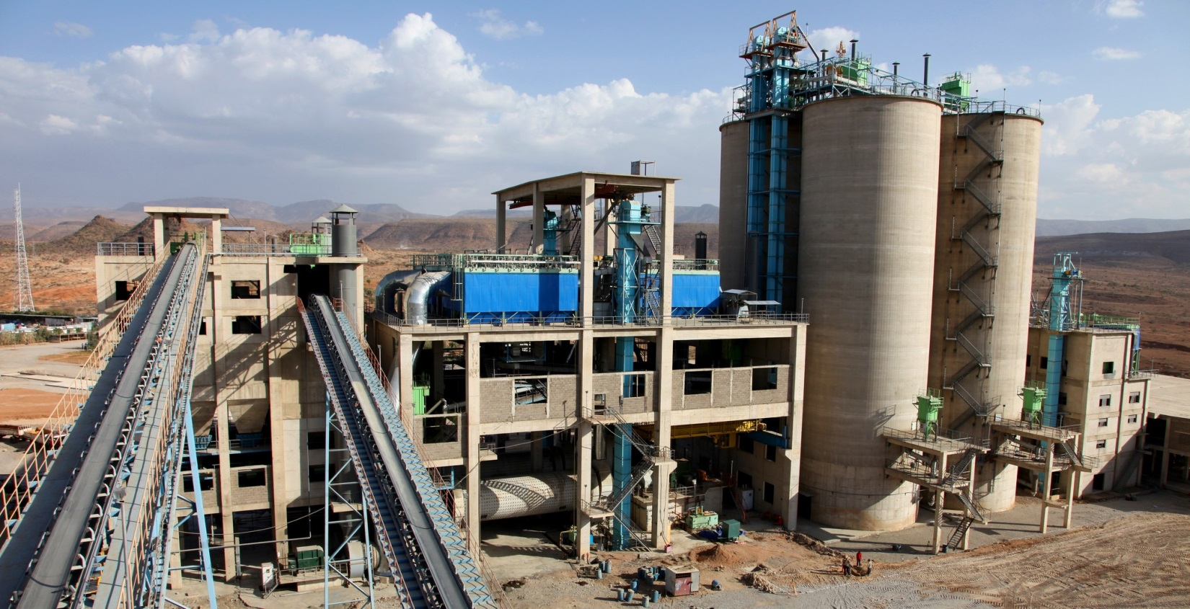


CLIMATE CHANGE MITIGATION
Waste management
Mozambique
Applicant: Ministry of Earth, Environment and Rural Development
National Designated Entity:
Mr. Antonio Jorge Raul Uaissone,
Ministry for Science and Technology
Duration: 12 months
Status: Completed
Budget: 50,000 USD
Planned by:
UNEP DTU Partnership
Implemented by:
UNEP DTU Partnership
Feasibility study to use waste as fuel for cement factories
Connecting Countries to Climate Technology solutions
CHALLENGE
Management and utilization of municipal solid waste as a fuel is a means to minimize methane emissions, avoid unhealthy living conditions near landfills, and to potentially commoditize waste as an energy source. Transforming waste to energy for the cement sector is a national priority in Mozambique.
The Climate Technology Centre and Network promotes the transfer of climate technologies at the request of developing countries for energy-efficient, low-carbon and climate resilient development.
By connecting stakeholders with technology experts from around the world, the CTCN delivers customized capacity building and technical assistance aligned with national climate objectives.
CTCN SUPPORT
Technical feasibility study on the potential and requirements for applying refuse derived fuel at cement factories
Economic feasibility study of such fuel and its usage in cement factories
Assessment of the current legal and regulatory framework for promoting waste to energy
Development of a measuring, reporting and verifying system covering the production and use of refuse derived fuel in cement factories, quality aspects and GHG emissions.
INTENDED IMPACT
According to the analysis, this technology has the potential to reduce 22,979 tCO2e/year by 2040. However, its application will require enhanced waste management and financial support in order to be technically feasible and financially viable.

Slide 2
















This ASSISTANCE SUPPORTS
Mozambique’s Nationally Determined Contribution to:
A mitigation reduction target of 76.5 MtCO2eq in the period from 2020 to 2030
What is climate technology?​
​
Any equipment, technique, practical knowledge or skills needed to reduce greenhouse gas emissions and/or adapt to climate change. This includes
traditional, modern and high tech technologies.
The Story
CTCN partner, UNEP DTU Partnership, provided technical assistance to determine the feasibility of the production of refuse derived fuel from municipal solid waste for use in cement factories in Mozambique, with a focus on two urban cities: Maputo and Matola.
The feasibility study showed that the use of refuse derived fuel is technically possible for cement factories and a number of enabling actions and conditions for such application were been identified.
However, the use of municipal solid waste for fuel production would not be economically feasible as its revenues would have to compete with natural gas prices, currently the main fuel utilized by cement producers. Various measures were highlighted which could improve the economic performance of a refuse derived fuel plant such as introducing a gate fee/waste handling tariff for waste disposal and partnering with alternative financing institutions like development banks.
Guidance was also provided on the legal and regulatory environment including that renewable energy policies in Mozambique should consider including waste as a suitable energy resource, in order to allow waste to energy projects access to relevant financial instruments, such as investment incentives, tax benefits, access to the electricity grid and competitive electricity tariffs.
Finally, strengthening social sustainability and inclusion, particularly with regard to informal sector waste workers into formal waste activities was strongly encouraged.
Learn more about CTCN technology transfer
Visit: www.ctc-n.org
Email: ctcn@unep.org
Follow:
The CTCN is the operational arm of the UNFCCC’s Technology Mechanism and is hosted by the United Nations Environment and the United Nations Industrial Development Organization (UNIDO).
UNFCCC_CTCN
UNFCCC.CTCN
The CTCN gratefully acknowledges the support of :

